Slide 1
CAD/CAM & CNC SIMULATION & PROGRAMING ASSIGNMENT
MEEG 301-18F

Slide 2
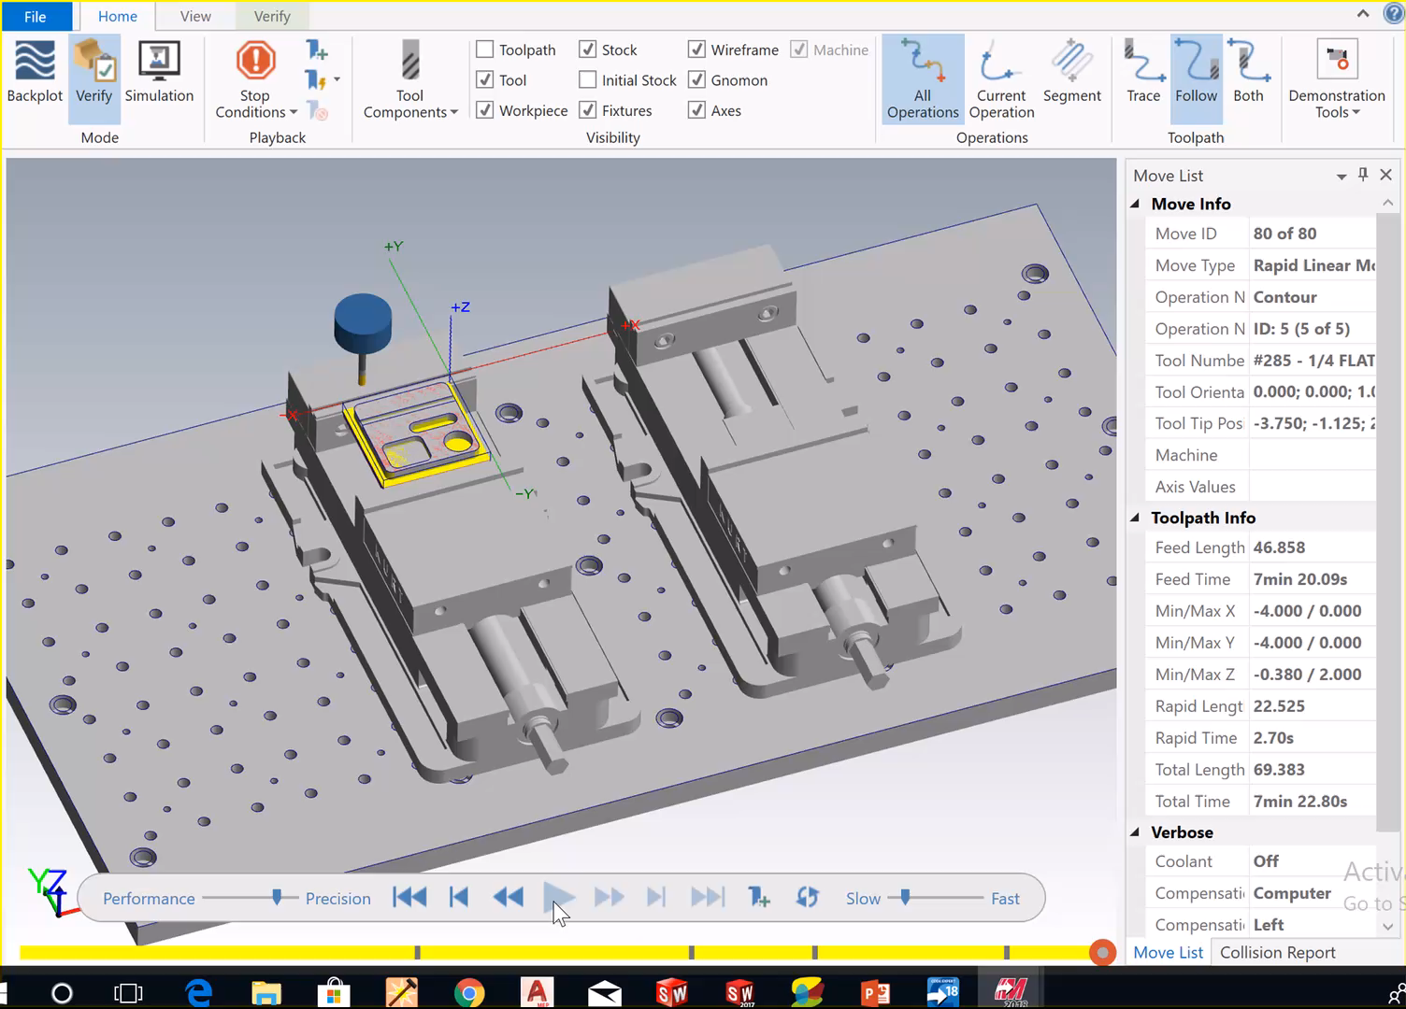
Simulation of Plate Tool Path in MasterCAM

Slide 3
Assignment Overview
For this assignment you will:
Use MasterCAM to generate a toolpath.
Run a MasterCAM simulation of the toolpath.
Use the simulation to calculate machining times.
Use MasterCAM to generate GCODE.
Explain the instructions conveyed in your generated code.
Submit your work to Canvas in a brief summary.

Slide 4
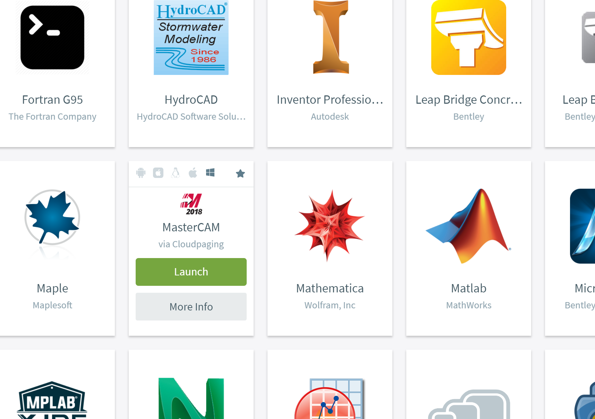
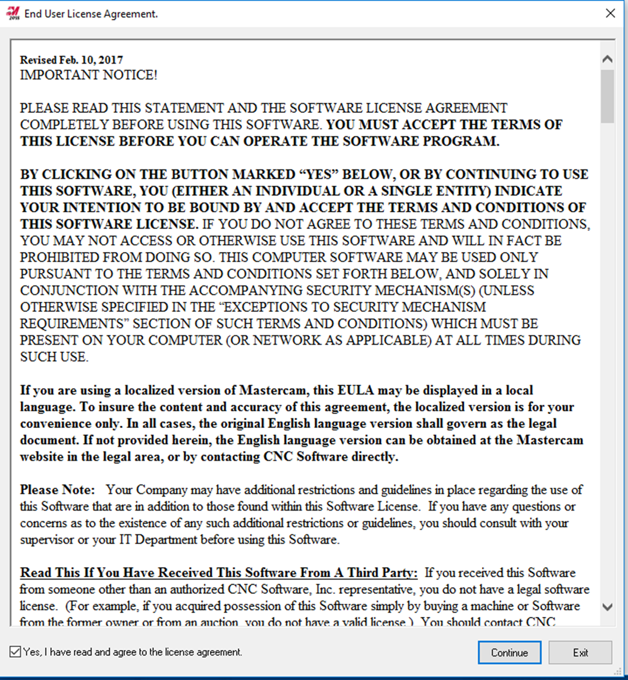
Access MasterCAM from AppsAnywhere
Navigate to: https://appsanywhere.engr.udel.edu
Sign in Using your UDEL login and password if prompted
Click Launch under
the MasterCAM logo
Wait, It will take a
few minutes to load
First time users may need to agree to MasterCAM’s License agreement
Note: AppsAnywhere may have trouble connecting to the server. If you get a network or license error, try again in a few seconds.

Slide 5
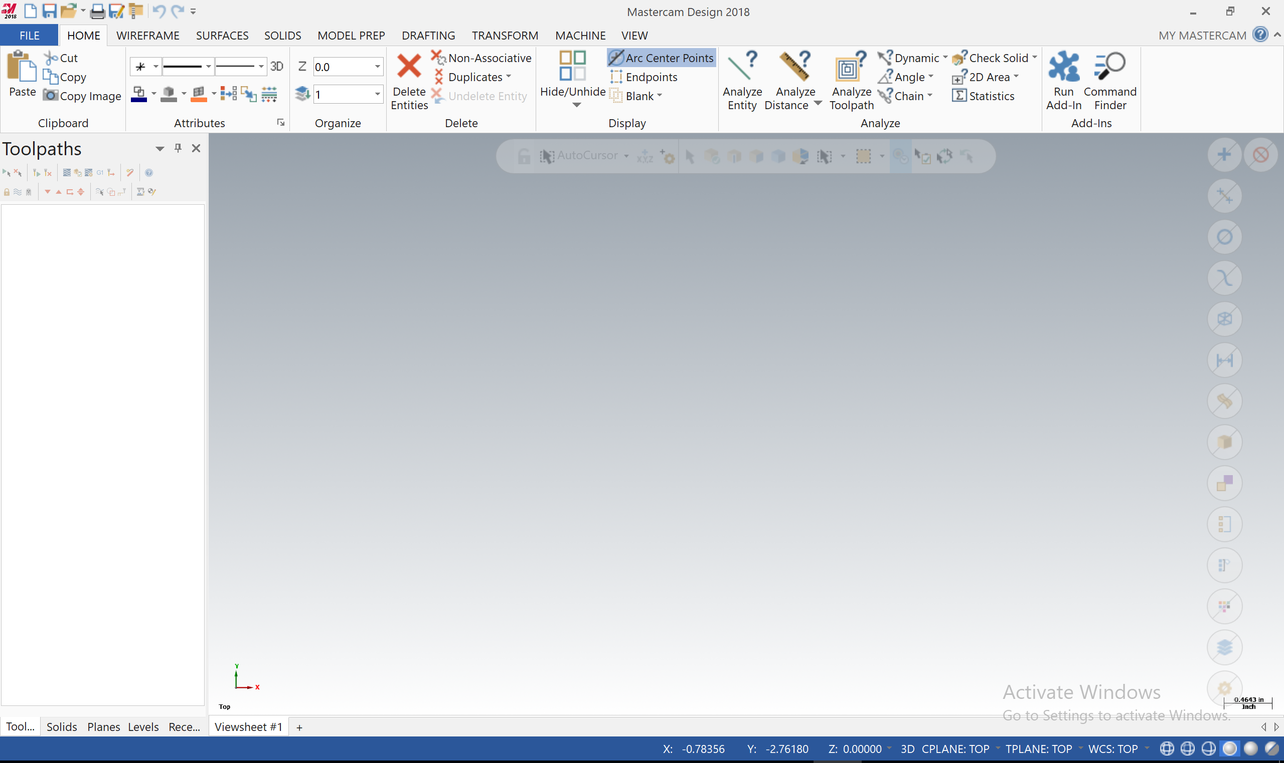
Starting up MasterCAM
You should see this screen when MasterCAM is ready to run.

Slide 6
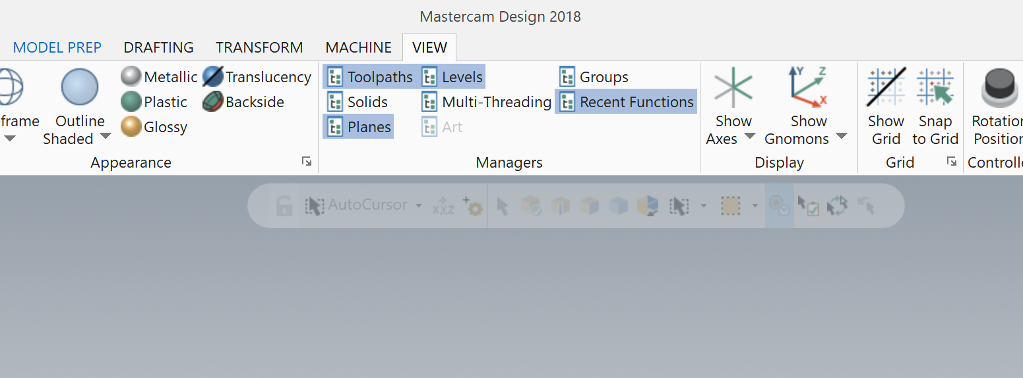
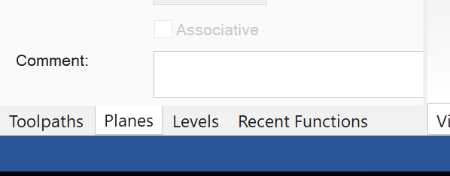
Setting up MasterCAM
Click on the View Tab
Turn on the necessary managers:
Toolpaths
Levels
Planes
Turning the managers “on” allows you to access them in the lower left corner of the screen.
3. Turn on “Show Axes” and “Show Gnomons”

Slide 7
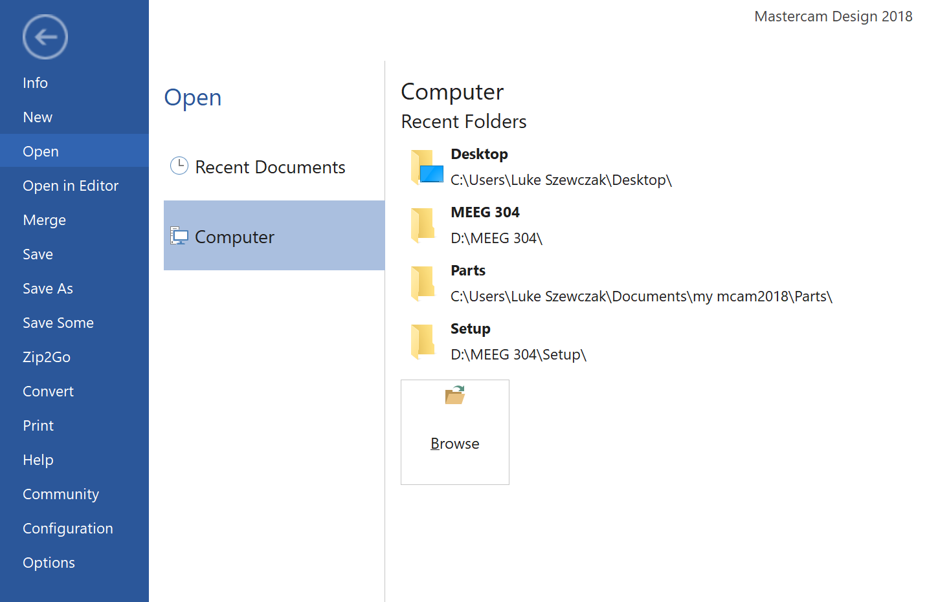
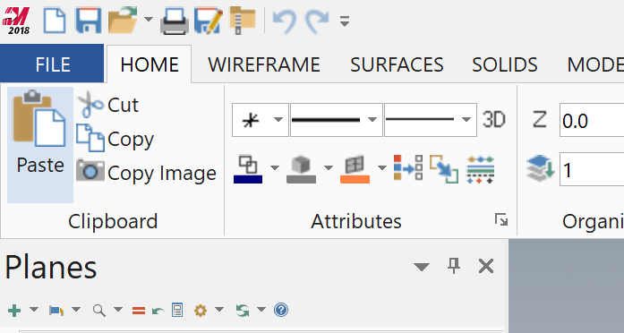
Open the provided MasterCAM file from Canvas
File
2. Open
2. Computer
3. Browse

Slide 8
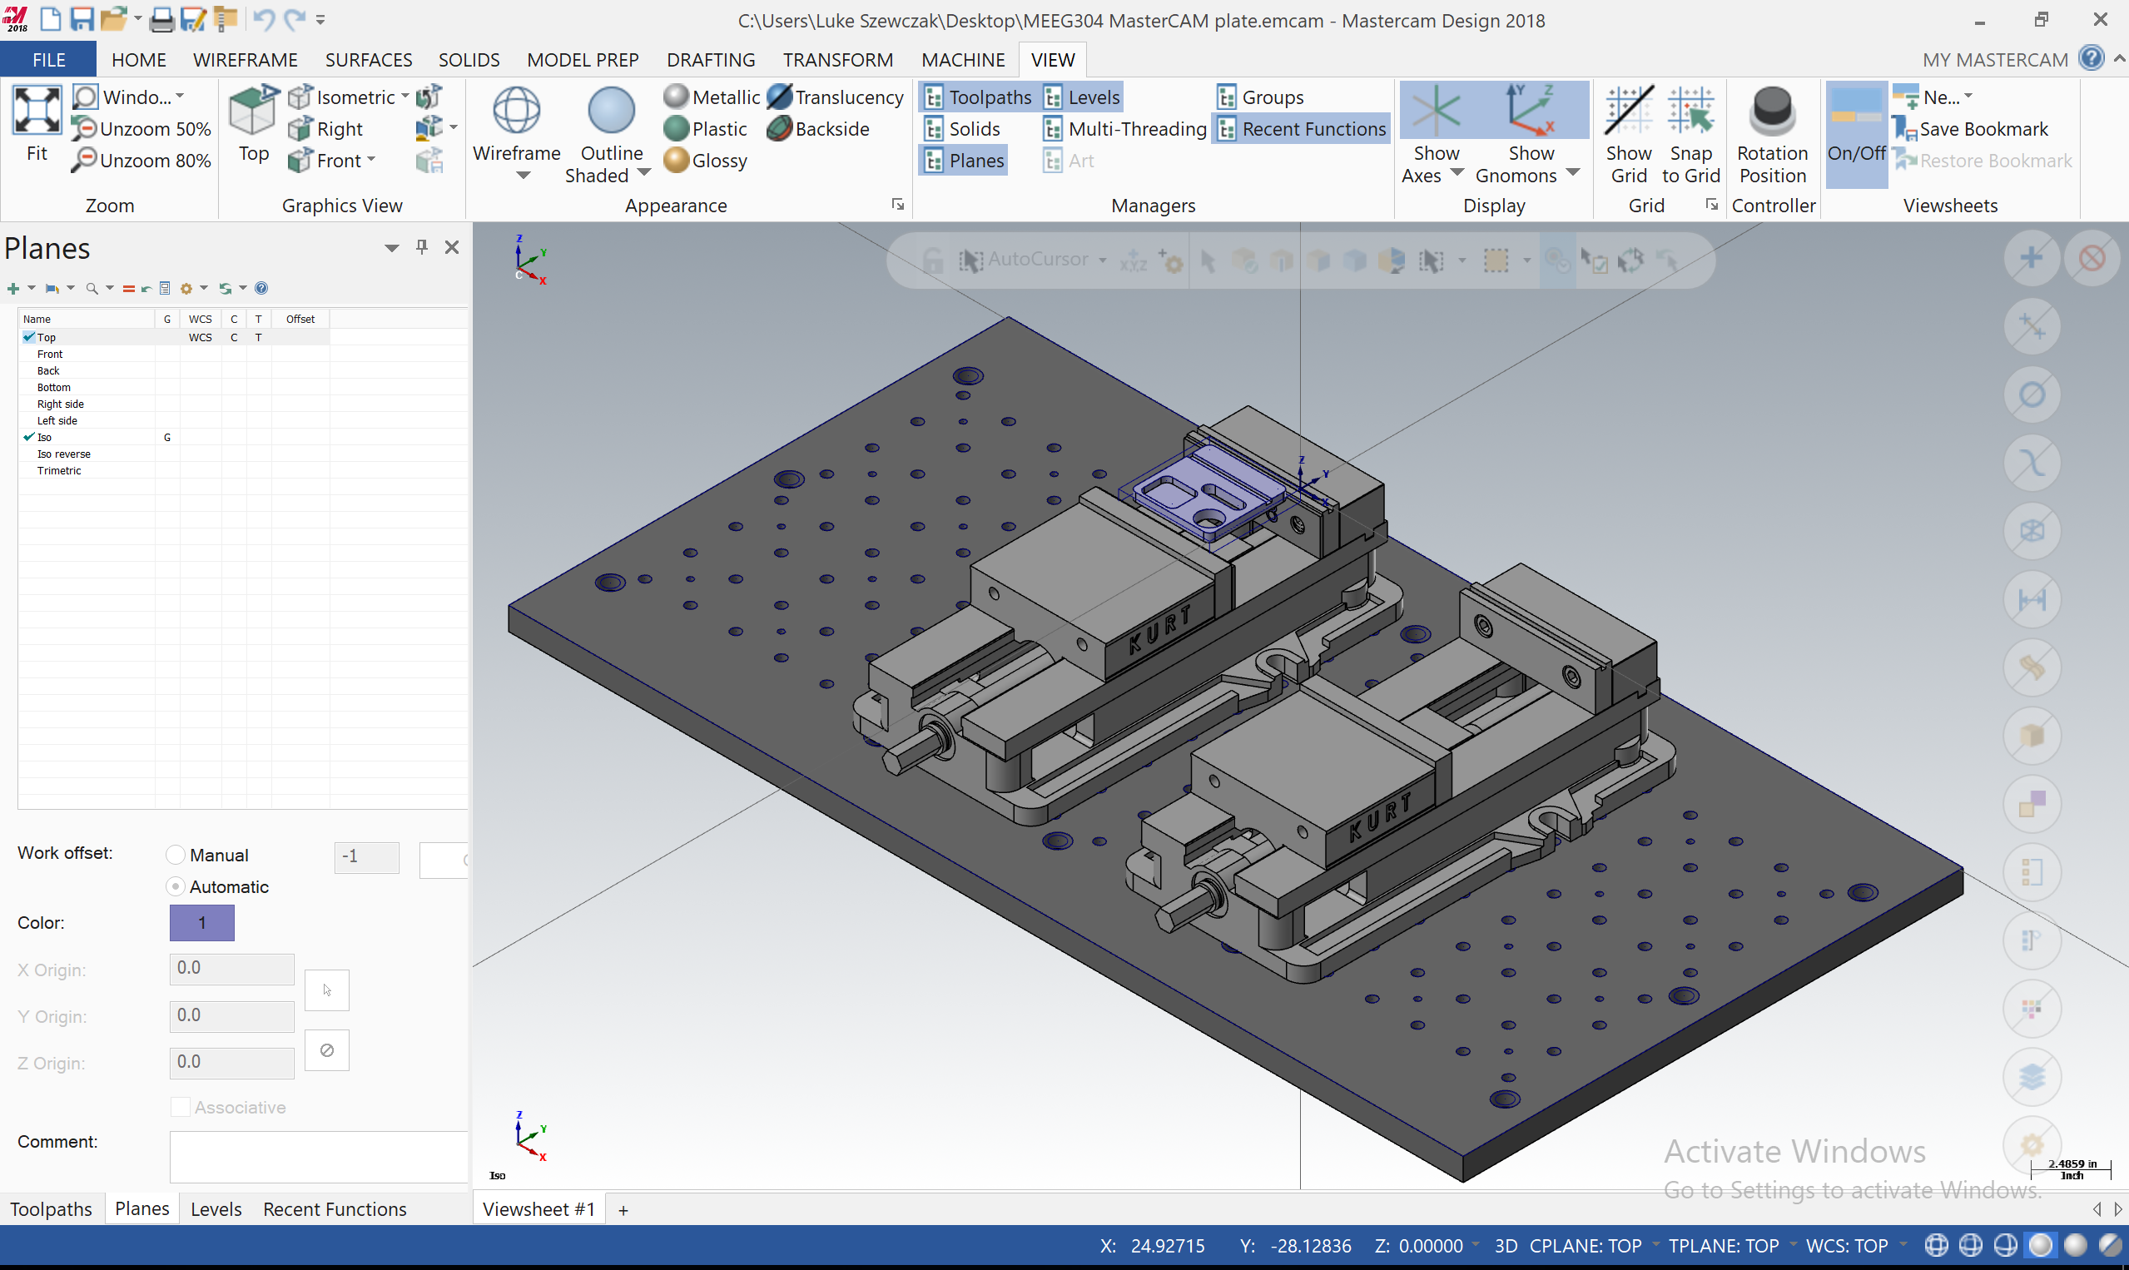
MAZAK Setup
You should see the custom mill setup for our MAZAK 3 axis mill.
This file has been already setup to include the solid model, vice, and parallels. Normally, you will need to set this up on your own in order to machine a part.

Slide 9
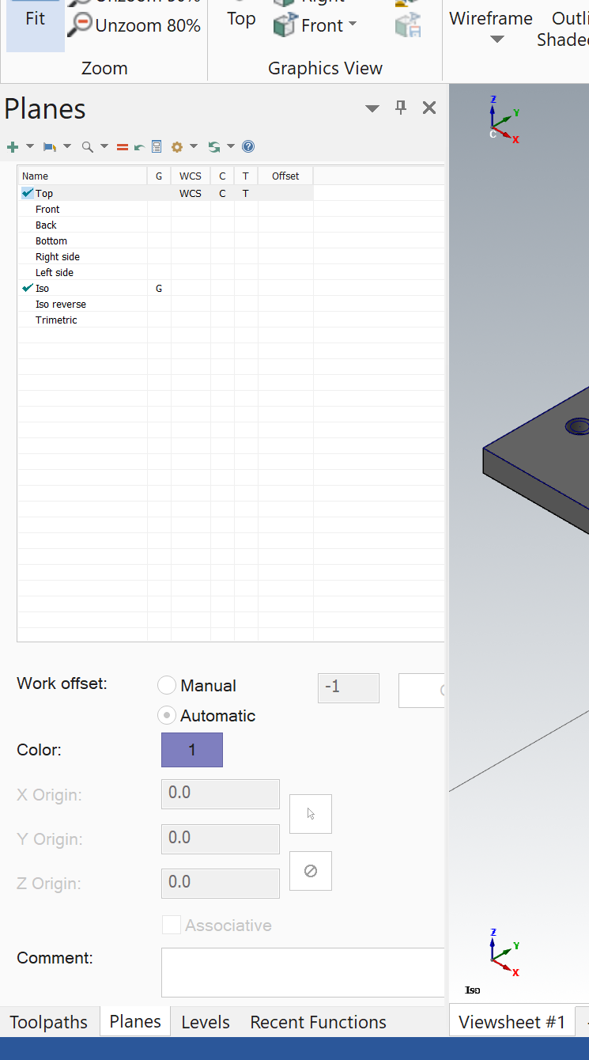
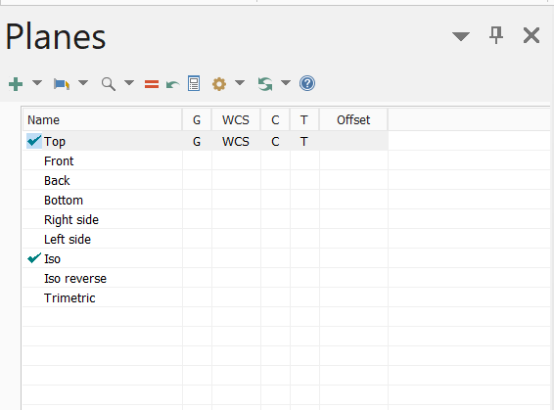
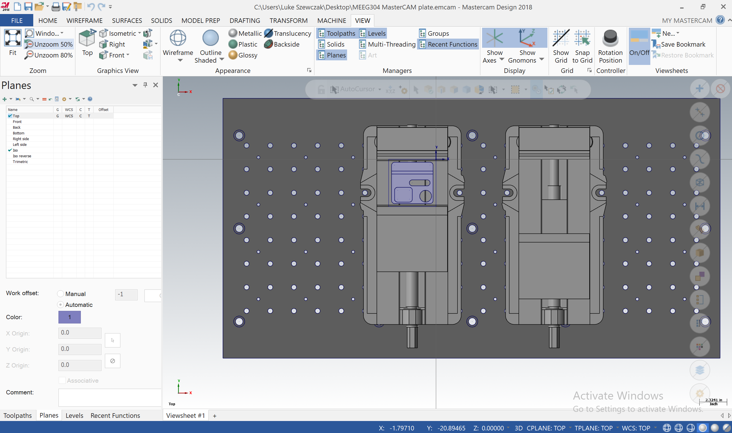
Rotate your view
Your “Planes” manager
should look like this
Click on all 4 boxes in
the “Top” plane view
Clicking on The “G” box will rotate your VIEW to the “Top” plane
Clicking on the “WCS”, “C”, “T” will allow you to work in the “Top” plane
Your screen should
look like this.
Click “Planes” to pull up the planes manager

Slide 10
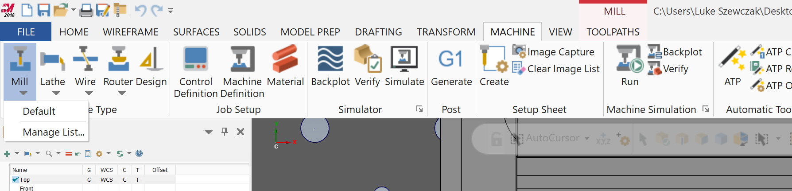
Select “Mill” Machining
4. “MILL TOOLPATHS” will appear, click on “TOOLPATHS”
1. Click “MACHINE”
2. Click “Mill”
3. Click “Default”

Slide 11
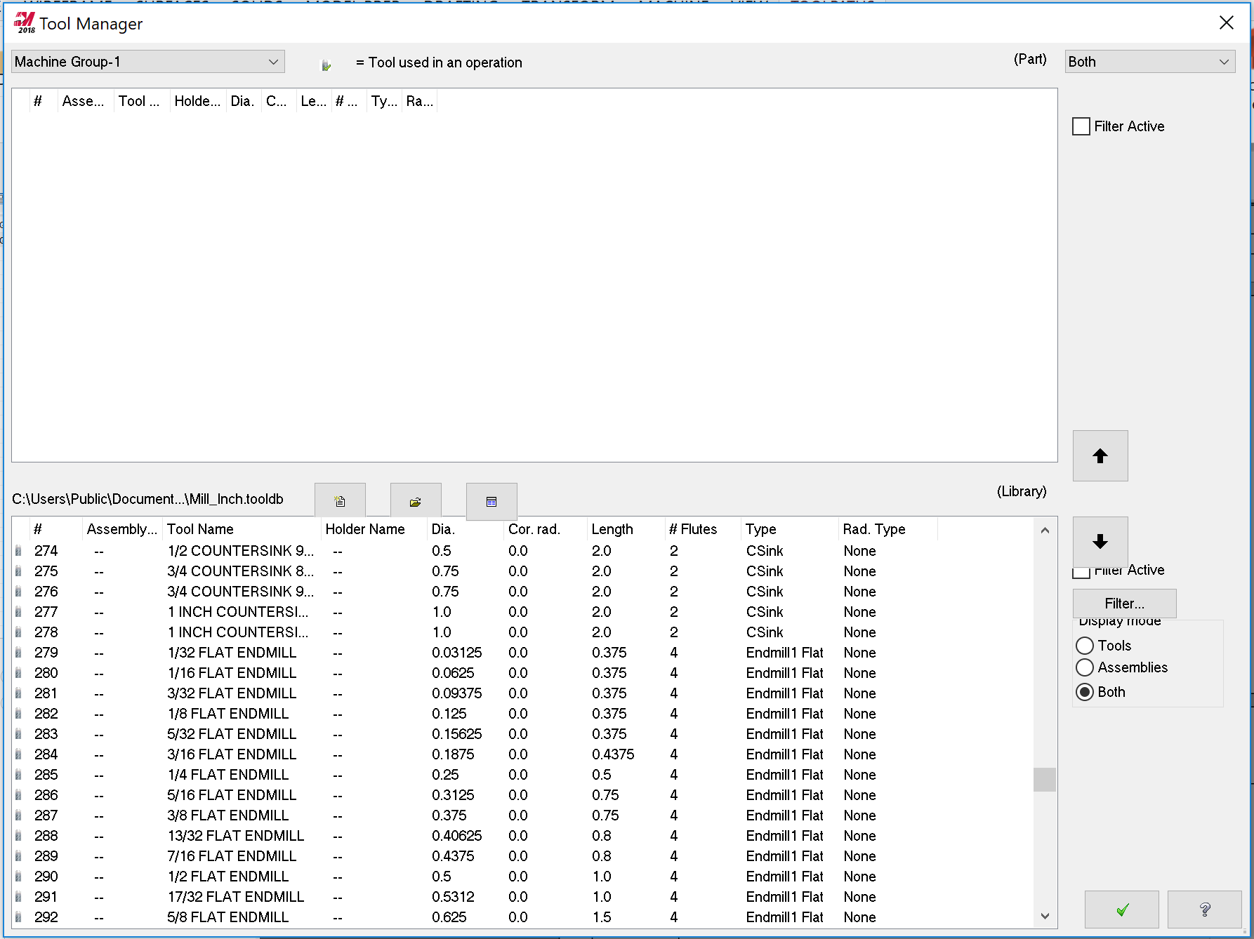
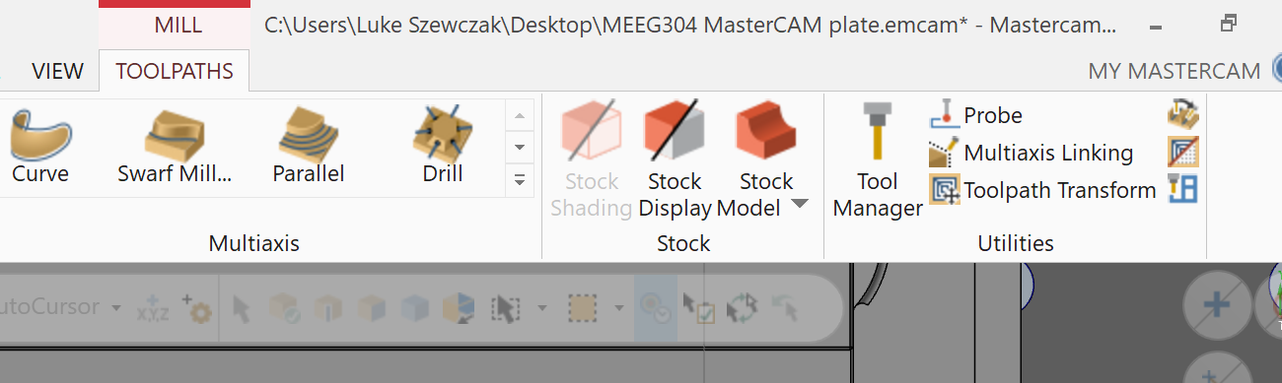
Select your Tools from the Tool Library
1. Open “Tool Manager”
3. Click Up Arrow to move tool to your active tool group
5. Click Up Arrow
Click on Tool #285 ¼ FLAT ENDMILL
6. Click “Check”
4. Click on Tool #290 ½ FLAT ENDMILL

Slide 12
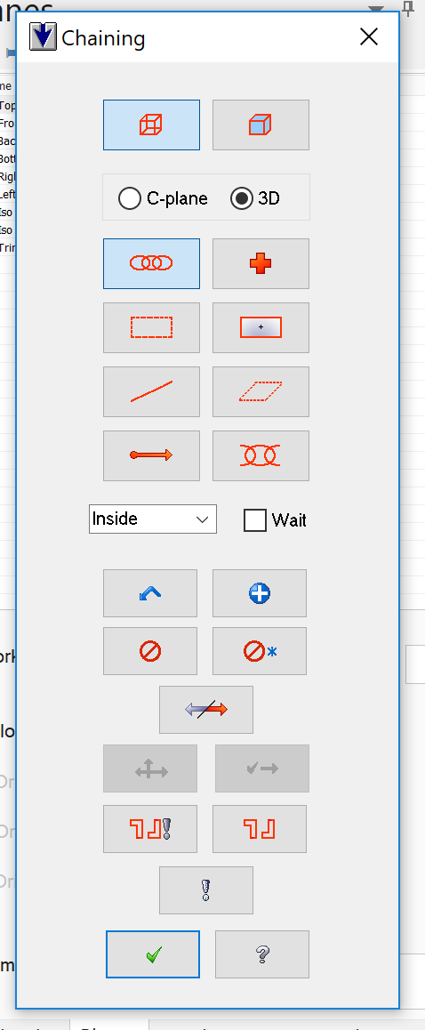
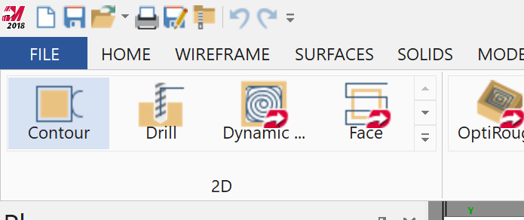
Machine the Outer Profile of the Plate
1. Under the 2D Machining Tab, select “Contour” to program the outer perimeter.
2. This will open your chaining menu. Here, you will need to select the chains for the toolpath to follow. A chain is a linked profile of lines and arcs that will define the geometry you wish to use to generate a toolpath.

Slide 13
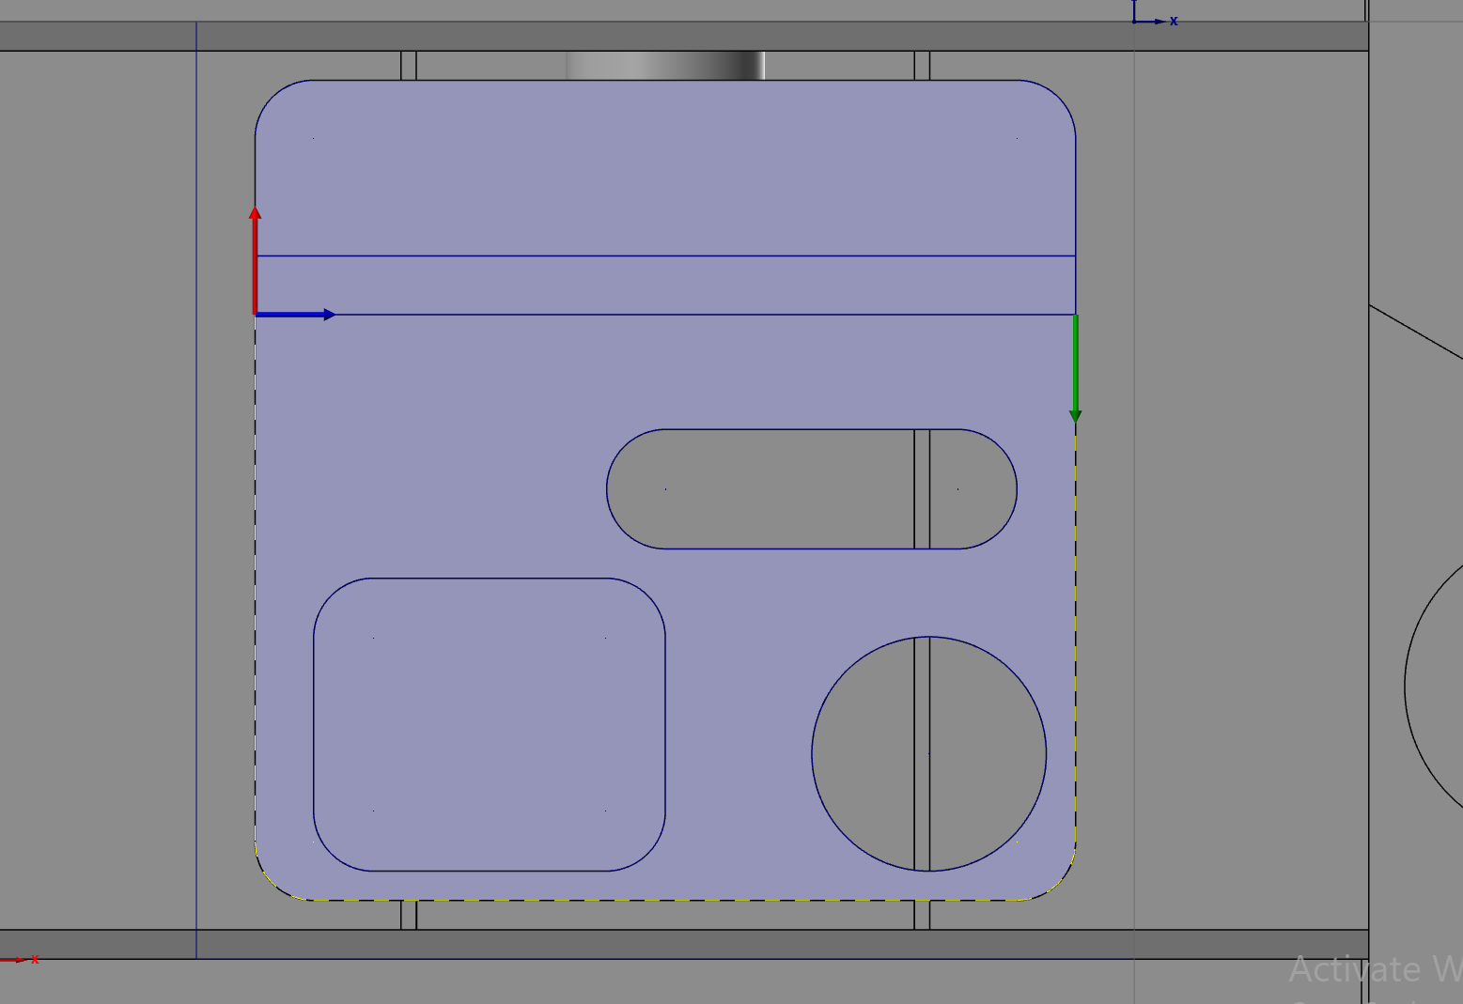
Machine the Outer Profile of the Plate
1. Select the chain
IMPORTANT: You must select the chain in exactly the correct orientation and order.
YOU WILL NOT GENERATE THE CORRECT TOOLPATH IF YOU SELECT THE WRONG GEOMETRY!
Click Exactly HERE.
The arrows MUST go around the perimeter clockwise in order to climb mill. If your arrows go counter clockwise you will NOT program the correct toolpath

Slide 14
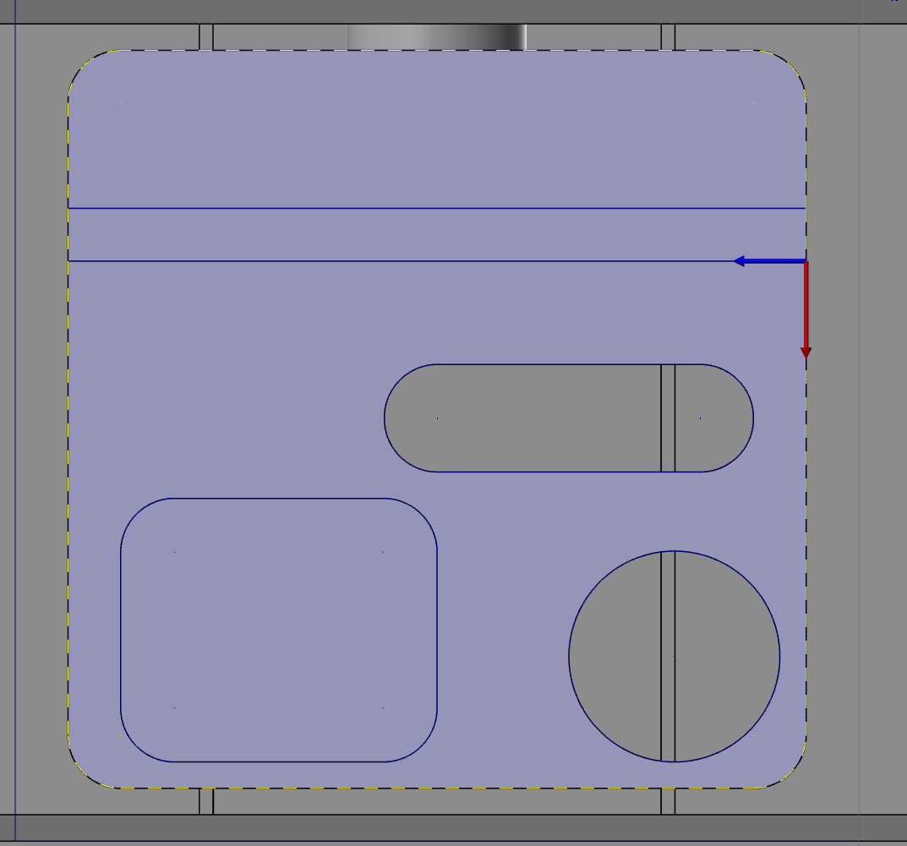
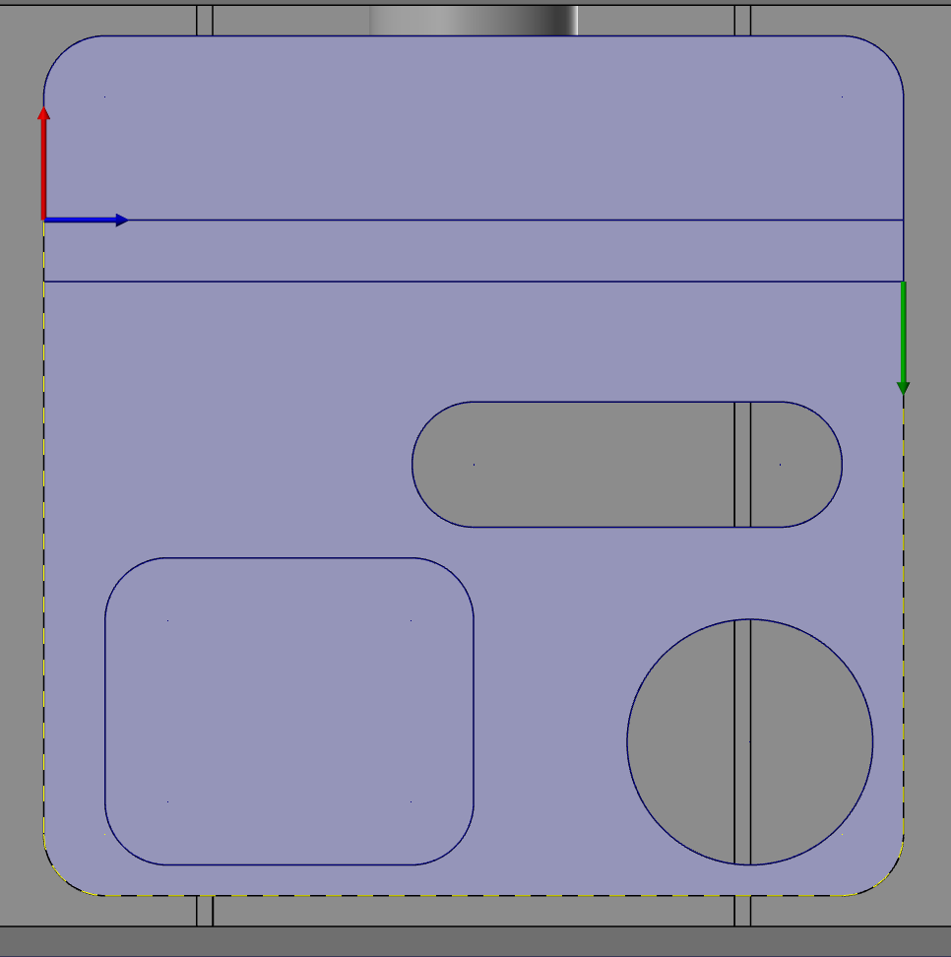
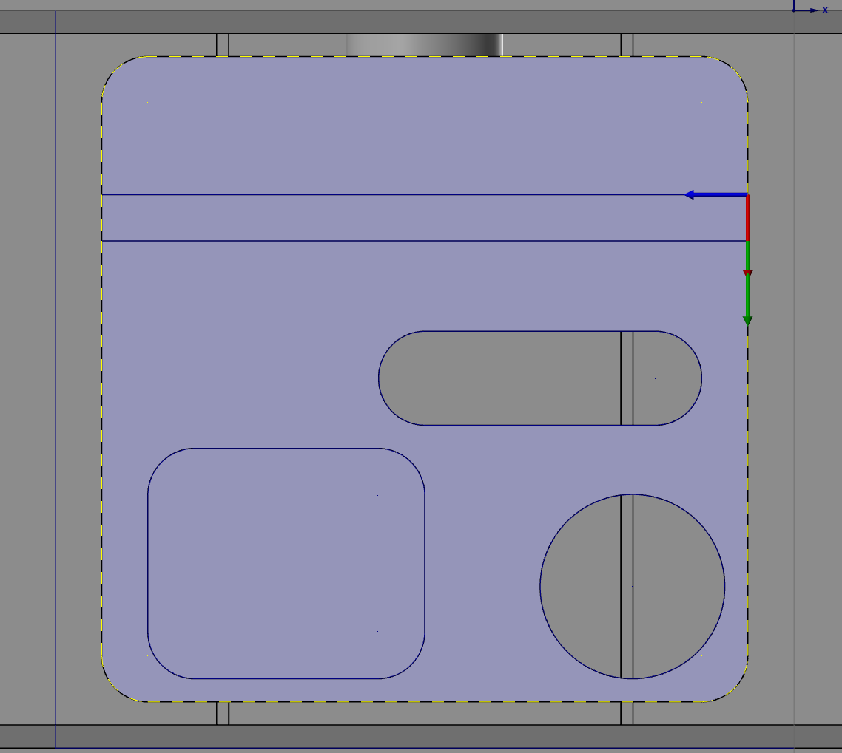
Machine the Outer Profile of the Plate
1. Select the rest of the chain by clicking on the suggestion arrows to extend the toolpath at junction points.
When your chain looks like this, you may move on by clicking the green check in the chaining menu .

Slide 15
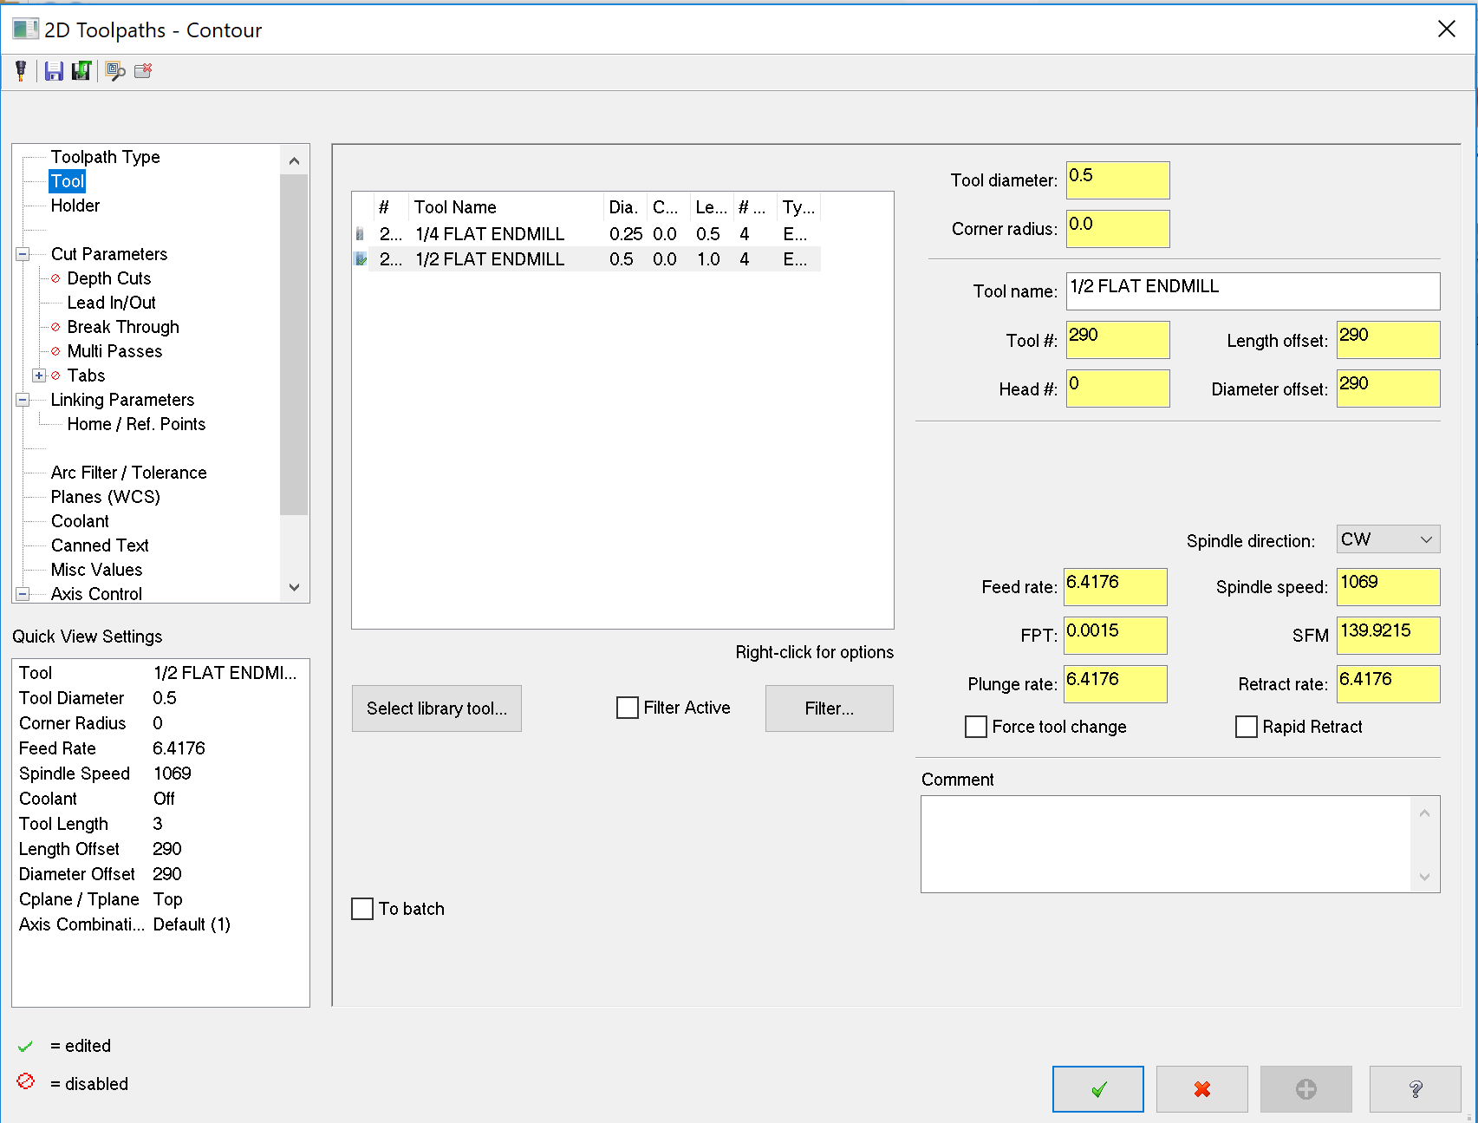
1. Click “Tool” to select your endmill.
2. Click “1/2 Flat Endmill” to select it.

Slide 16
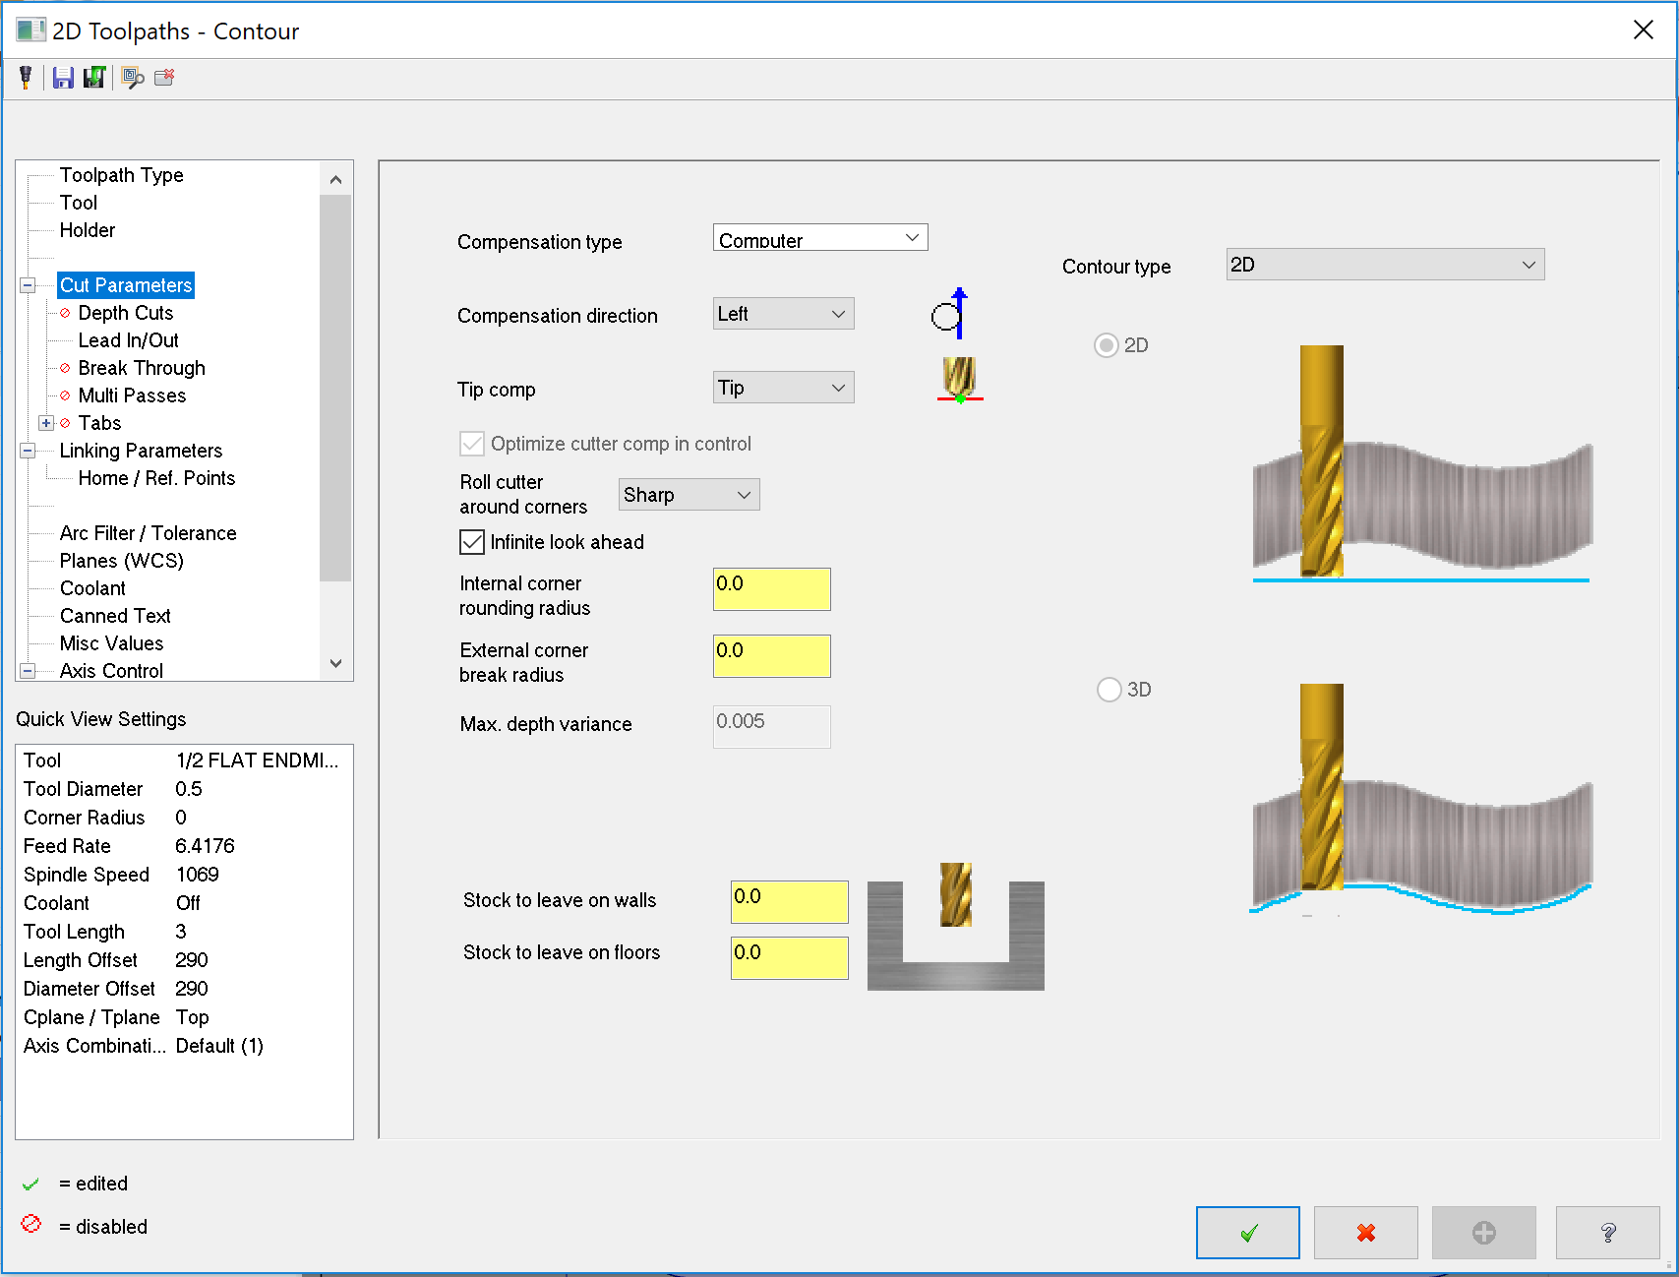
1. Click “Cut Parameters” to define machine compensations.
2. Make sure both these values are 0.0 to leave no material for a finish pass

Slide 17
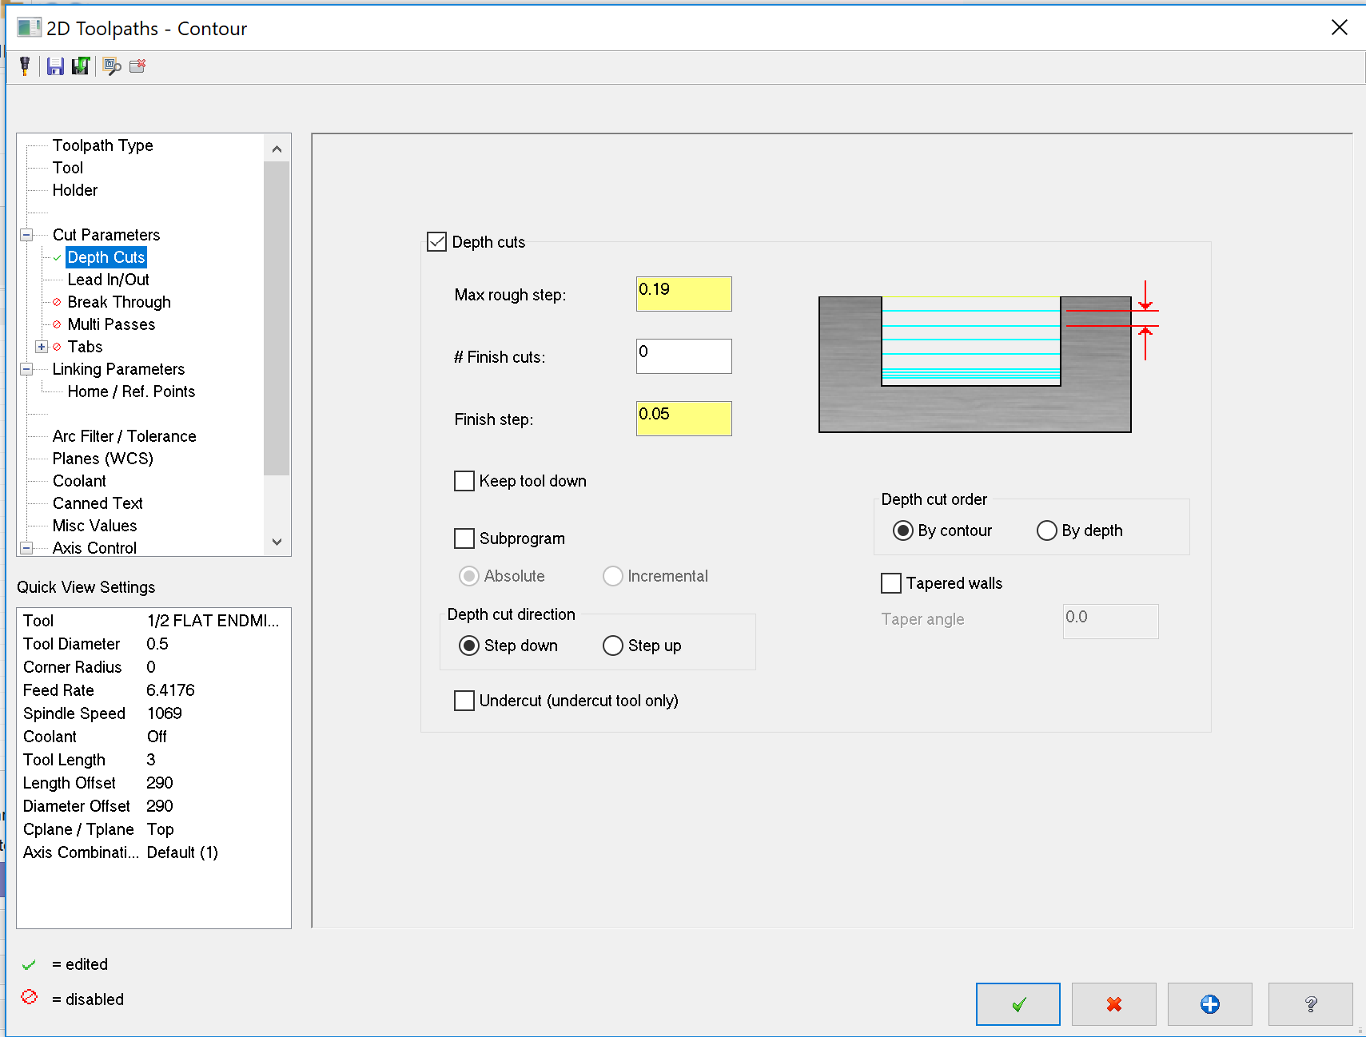
1. Click “Depth Cuts” to define each pass depth.
2. Check the “Depth Cuts” Box
3. Set “Max Rough Step” to 0.190, to define our maximum depth of pass.

Slide 18
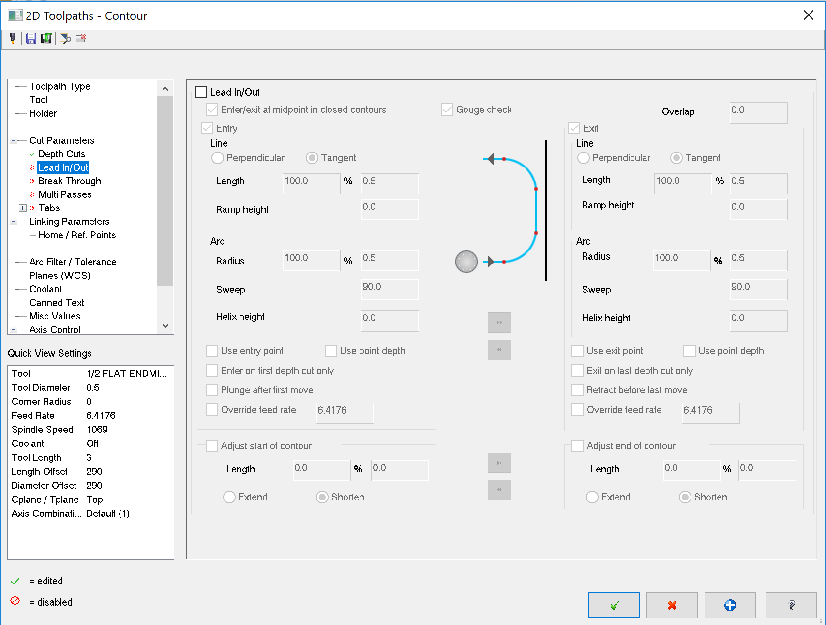
1. Click “Lead In/Out”.
2. Turn Lead In/Out OFF

Slide 19
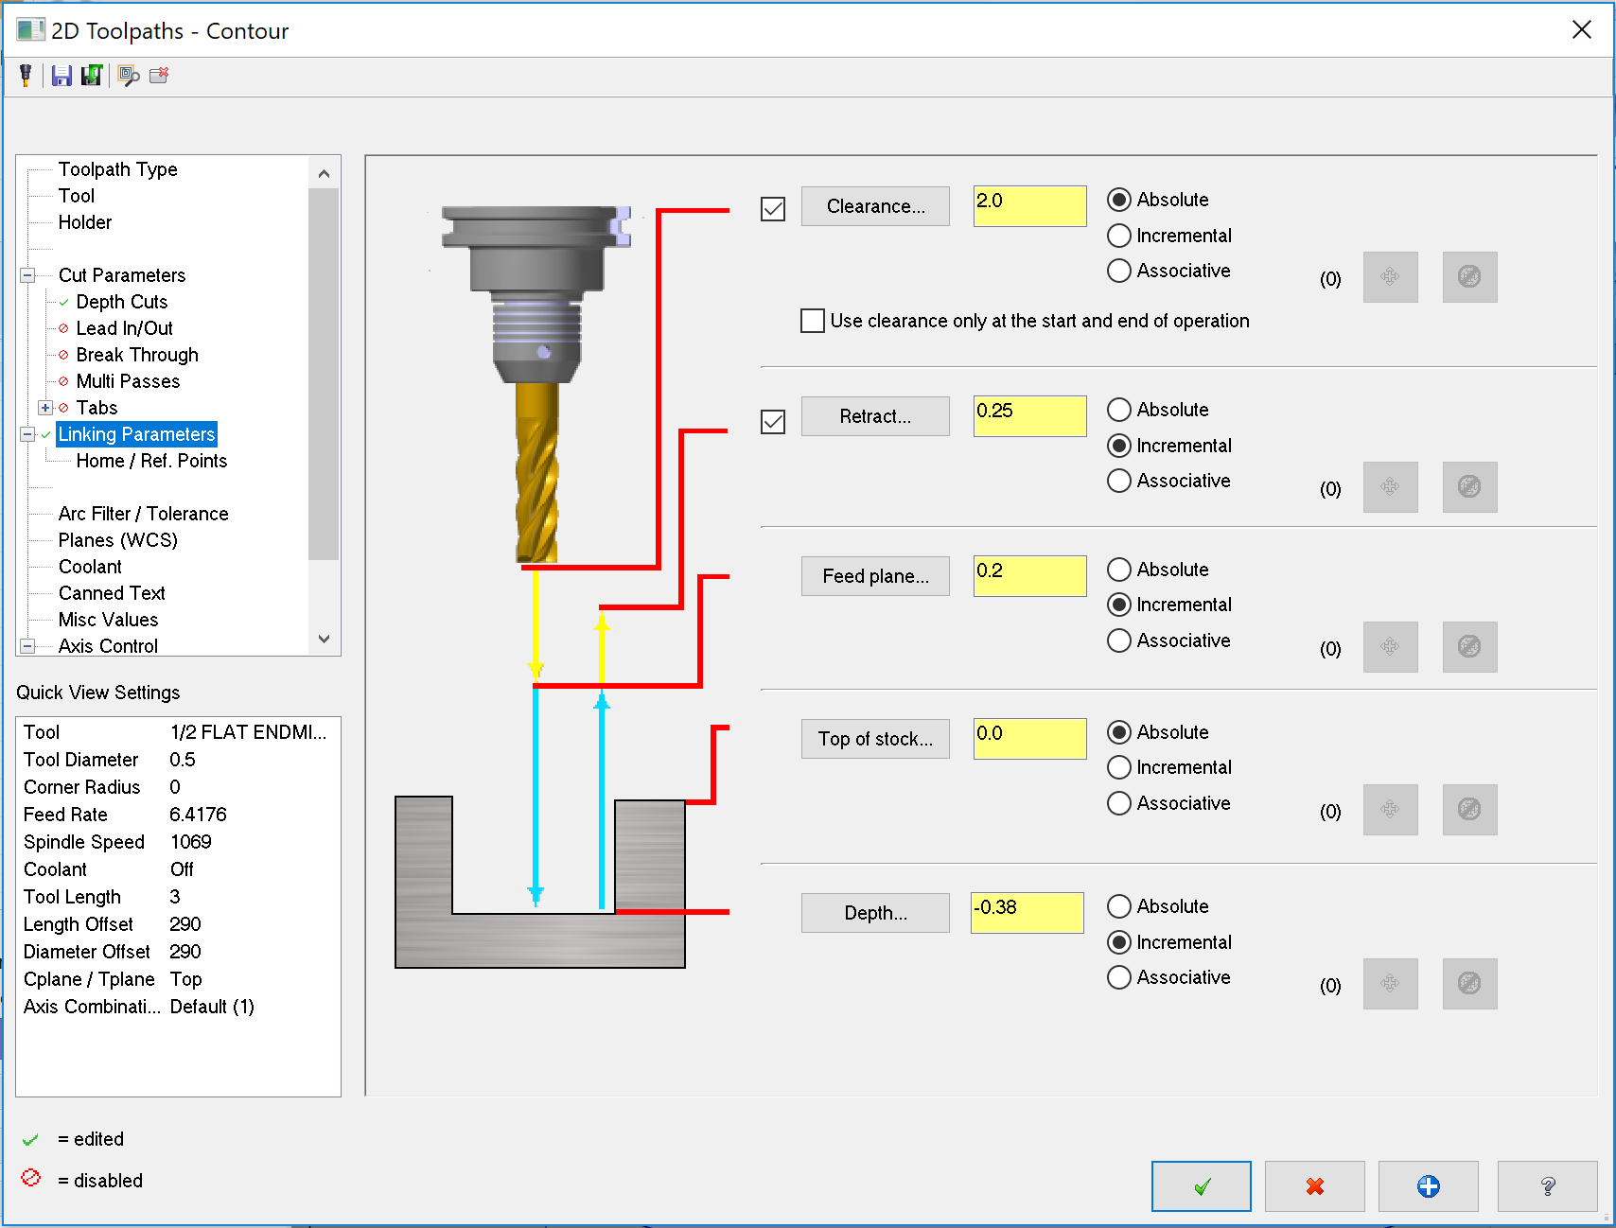
1. Click “Linking Parameters”.
2. Turn on the Clearance plane (the default height of 2.0 will be sufficeint)
3. Make sure the “Top of stock” is defined at 0.0.
4. Set the “Depth” to -0.380, to set our depth of cut.
5. Confirm

Slide 20
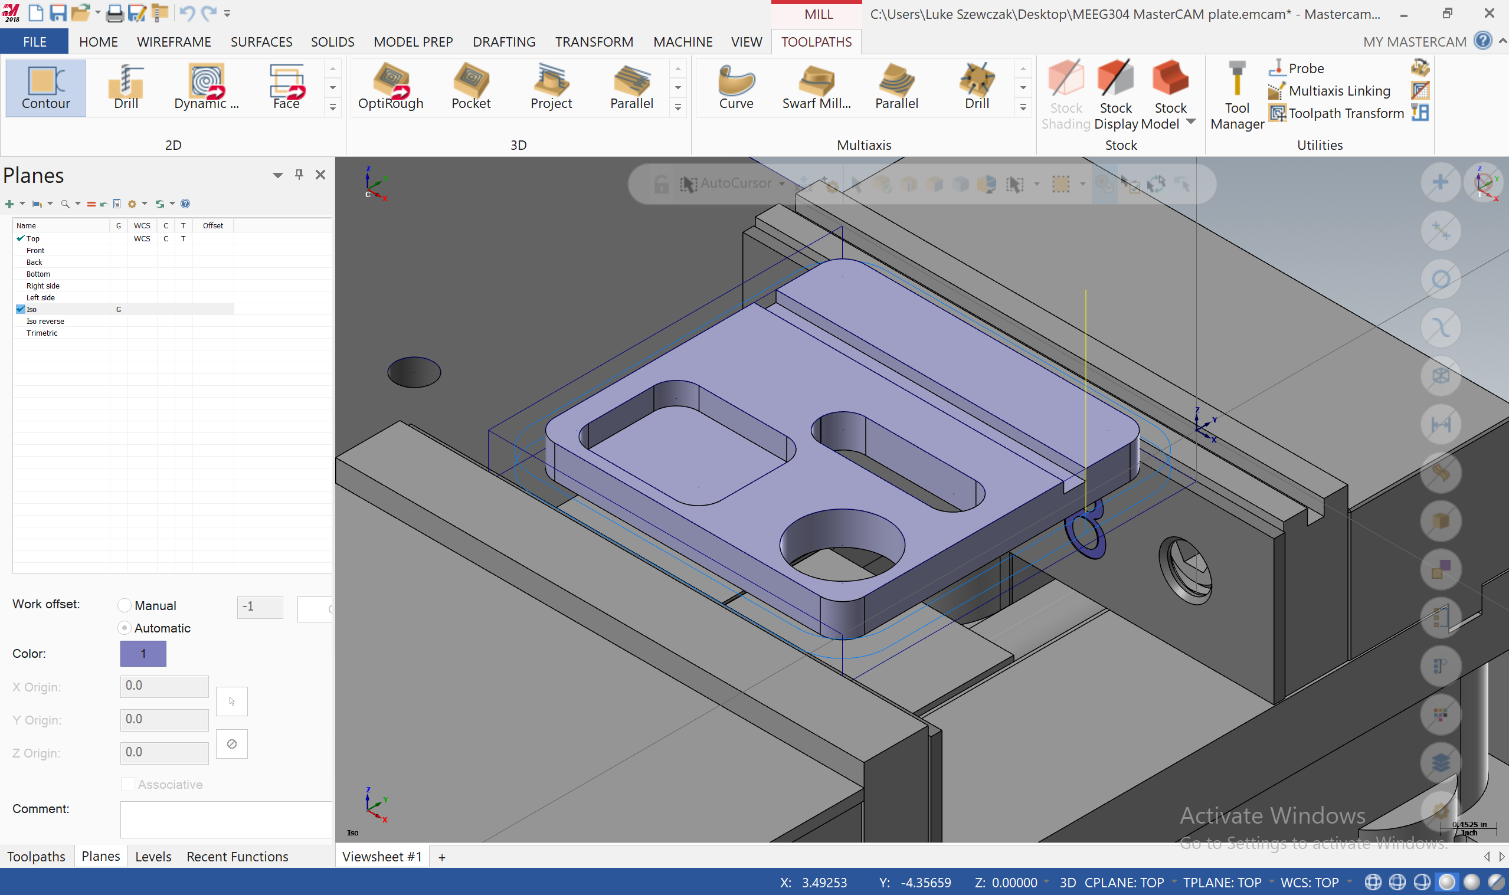
By selecting Isometric view, we can see the generated toolpaths around the part.

Slide 21
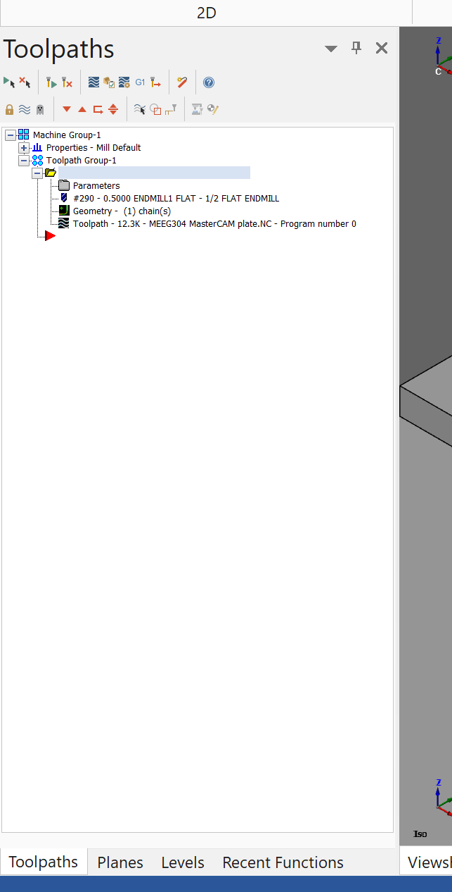
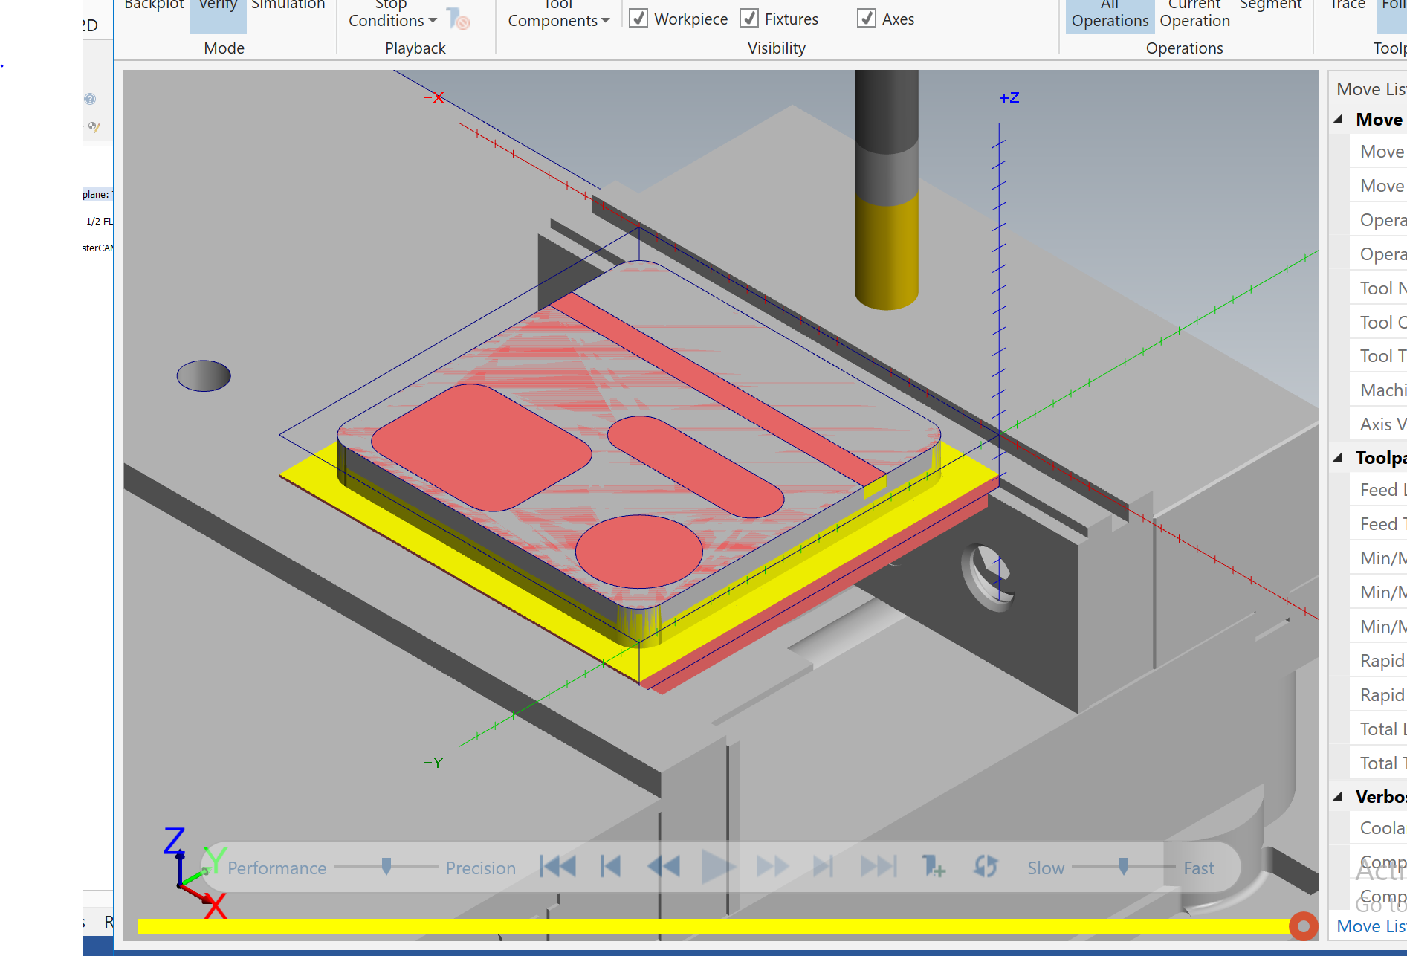
By right clicking on a tool path, in the toolpath manager tab we can open a MasterCAM simulation window.
Click Play to watch the toolpath run.

Slide 22
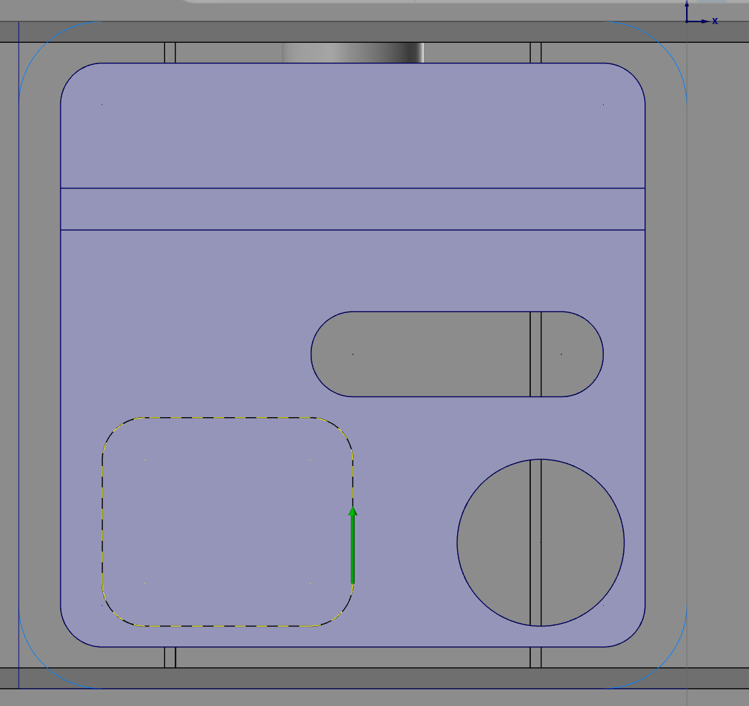
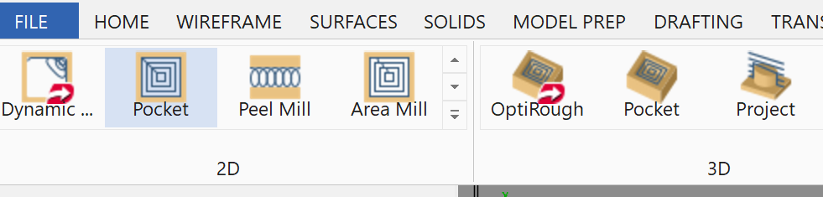
Machine the Rectangular Pocket
1. Under the 2D Machining Tab, select “Pocket” to program the Rectangular Pocket.
Select the Profile shown.
NOTE: THE ARROW MUST POINT COUNTER CLOCKWISE!

Slide 23
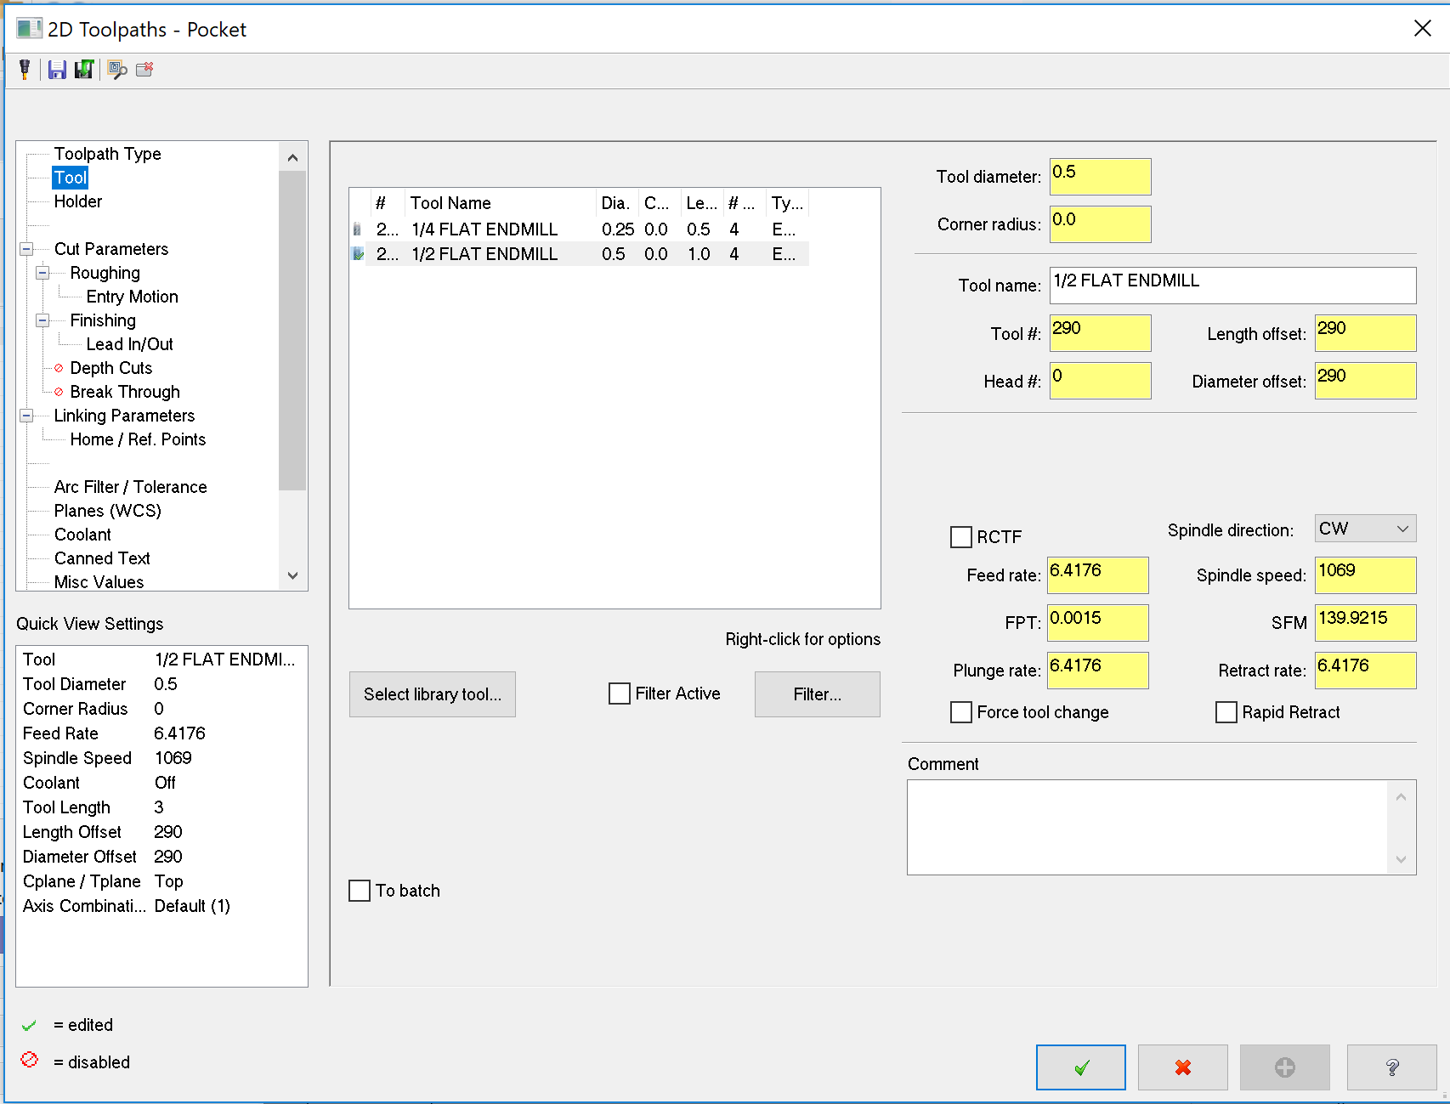
Select the “½ Flat Endmill”

Slide 24
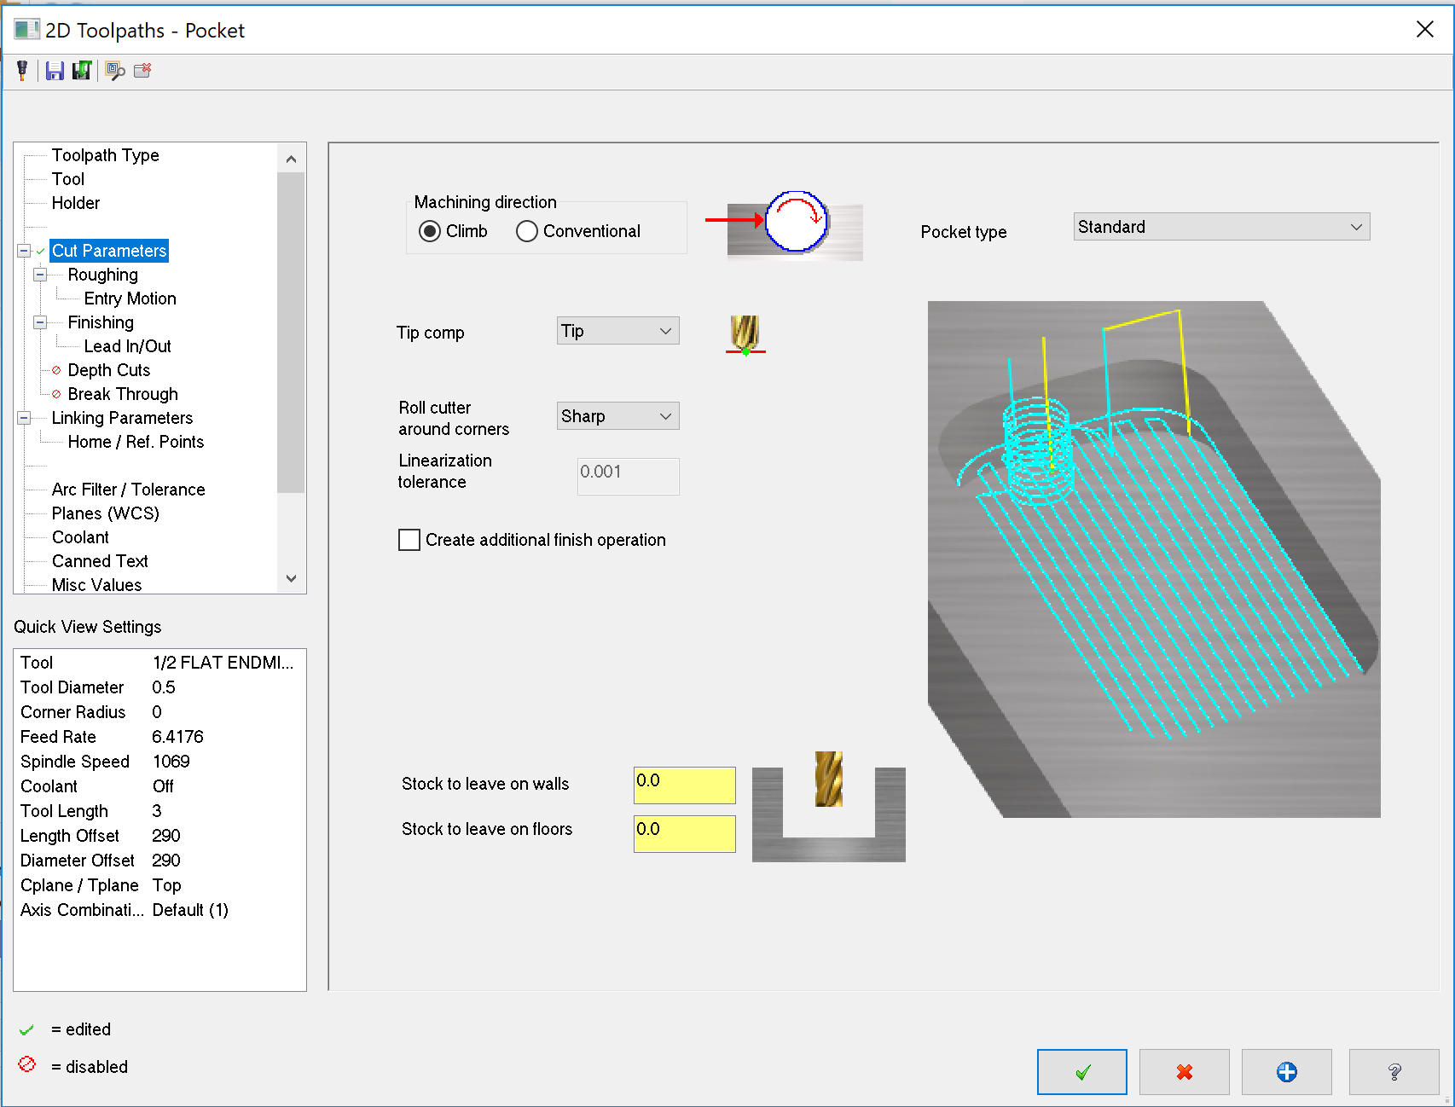
Make sure to leave 0 stock on the walls or floor for a finish pass.

Slide 25
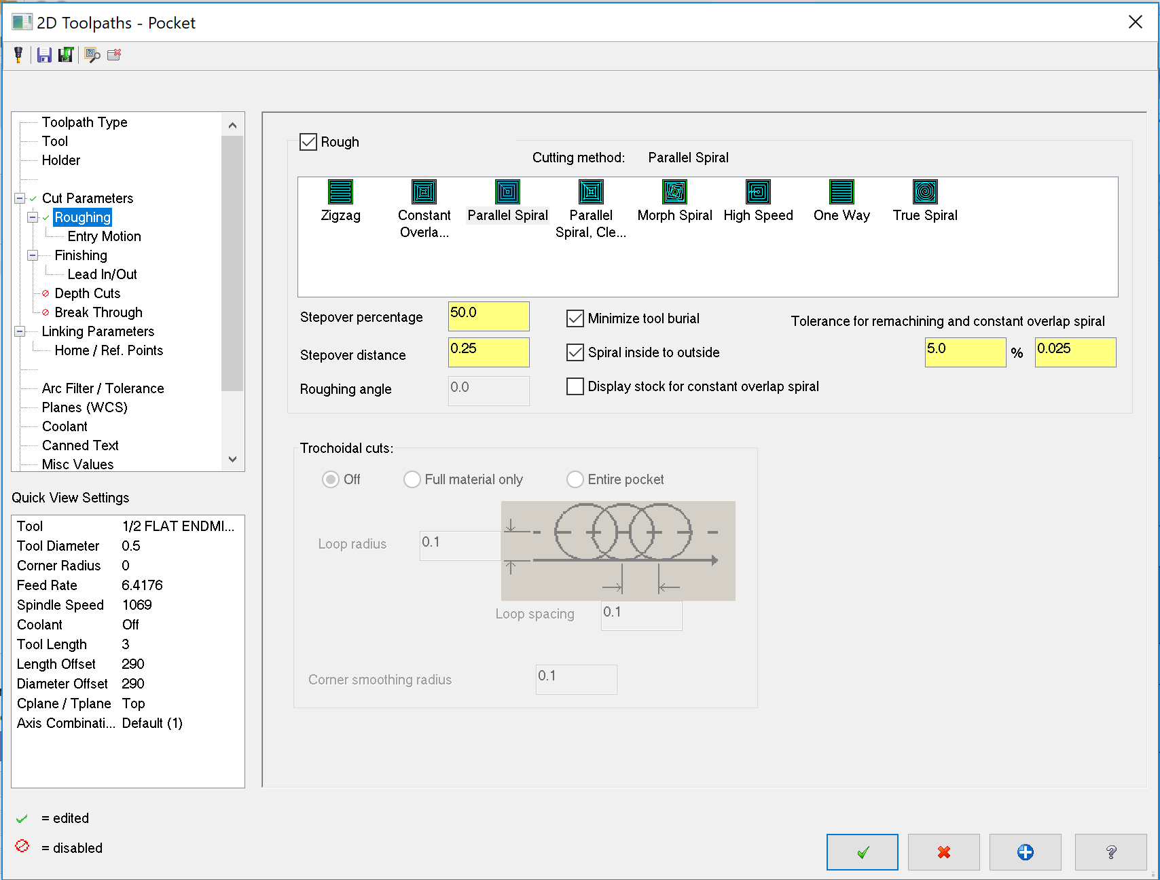
1. Click “Roughing”
2. Double click the “Parallel Spiral” Roughing Method

Slide 26
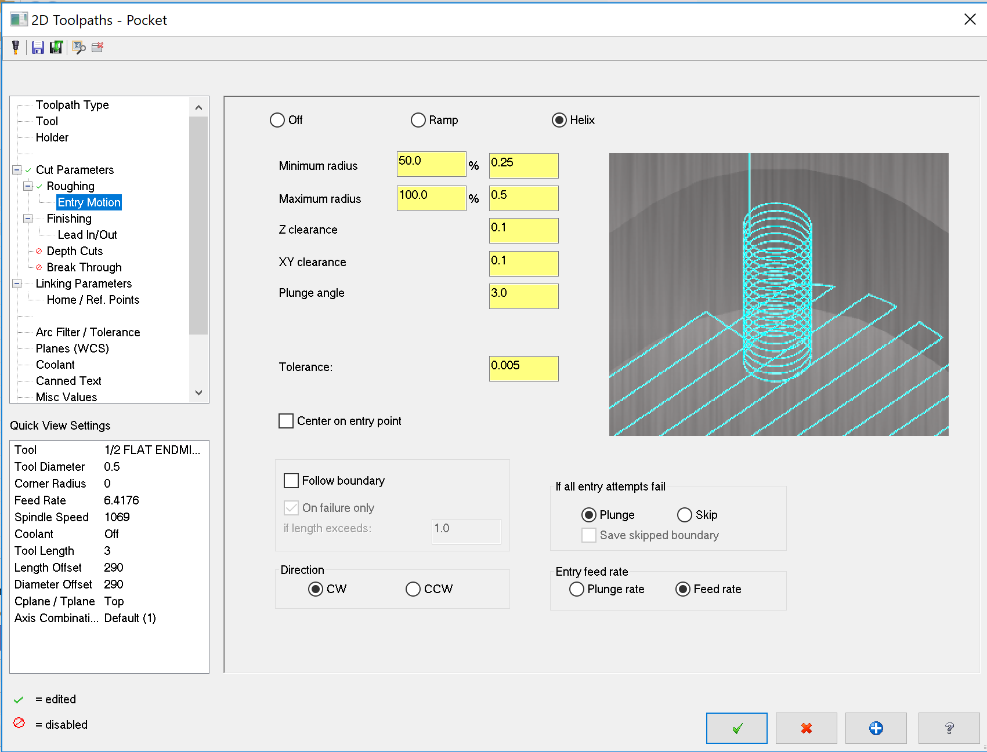
1. Click “Entry Motion”
2. Turn off the Entry Motion for simplicity.

Slide 27
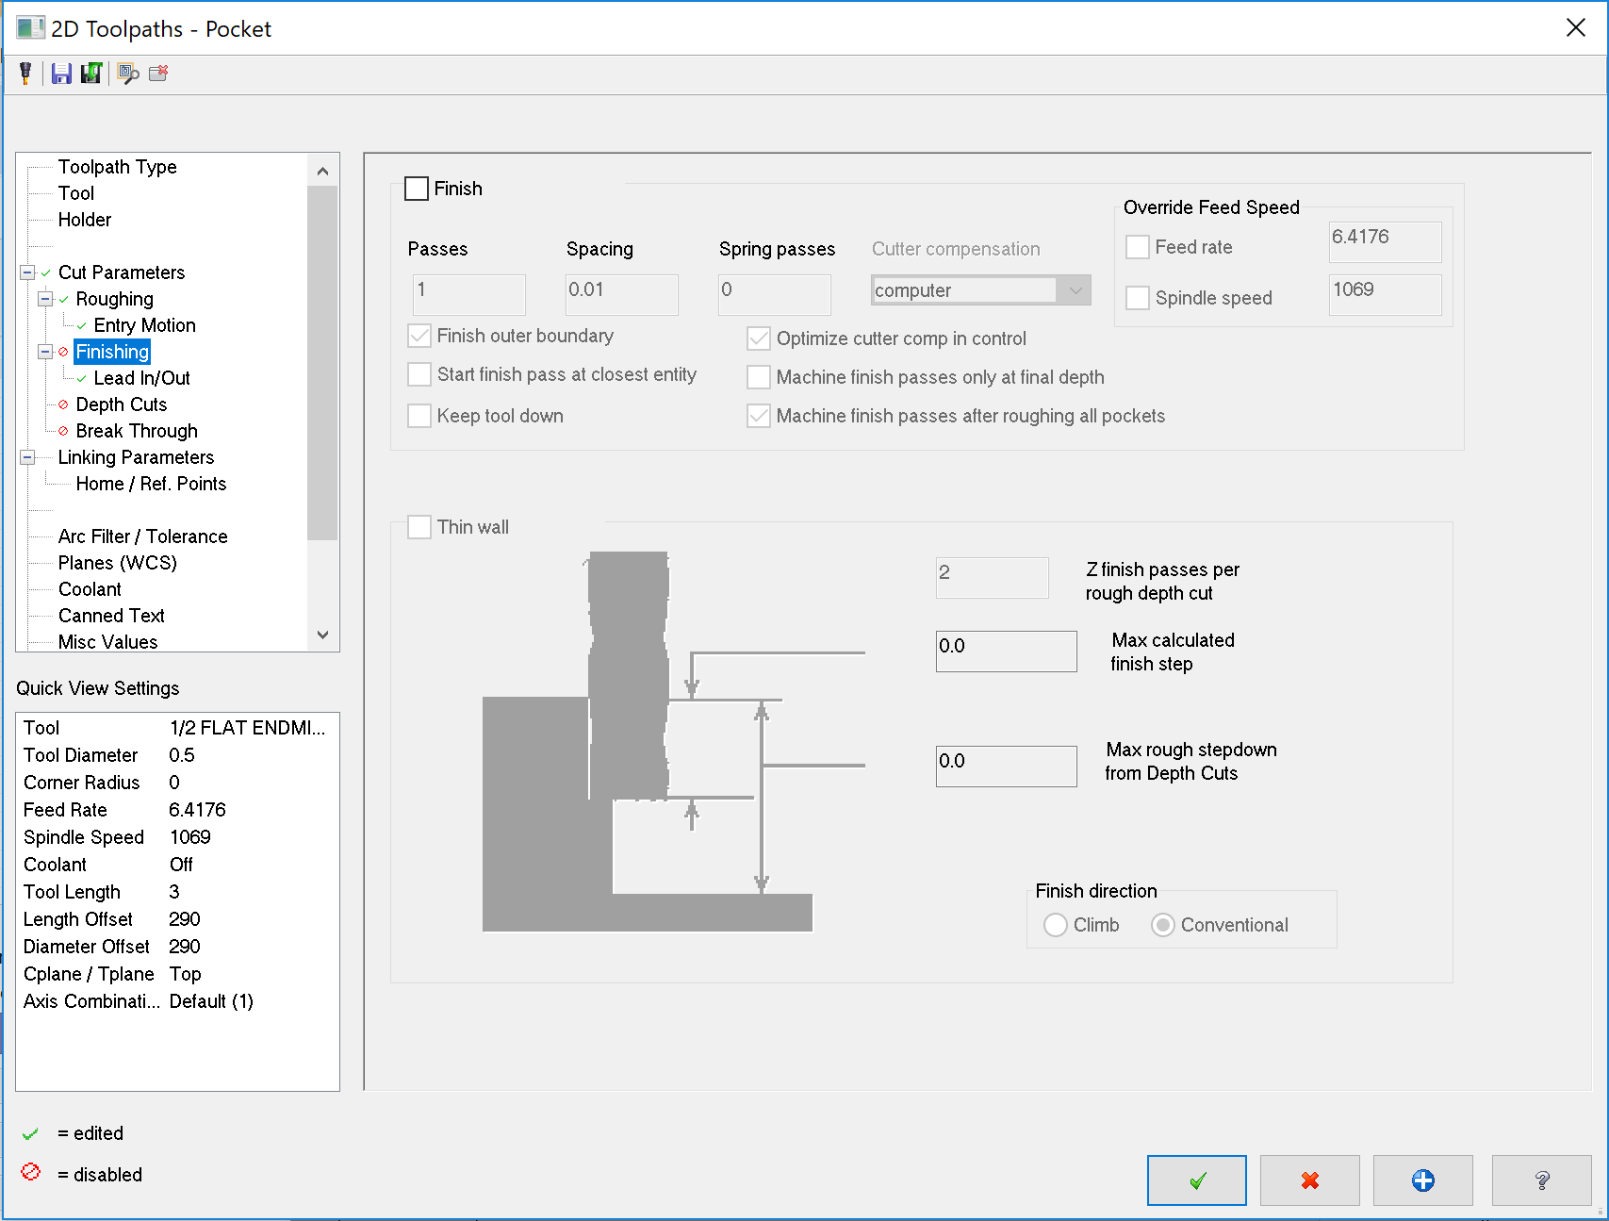
1. Click “Finishing”
2. Turn off the Finish Pass.

Slide 28
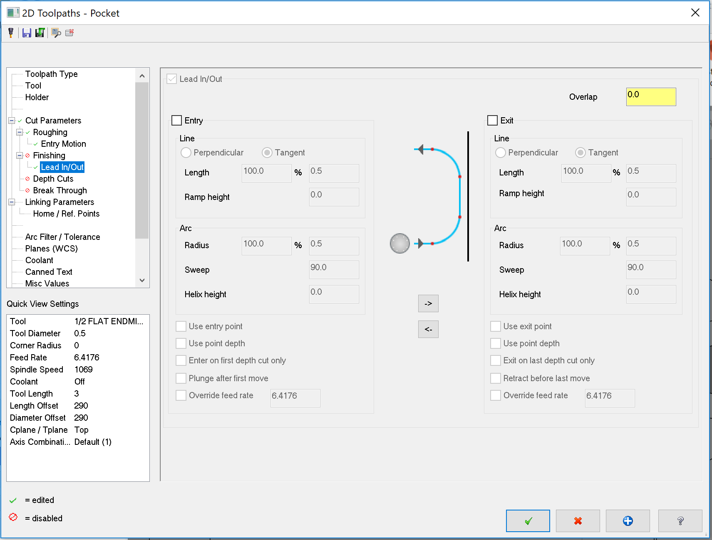
1. Click “Lead In/Out”
2. Turn off both the Entry Lead In and Exit Lead Out

Slide 29
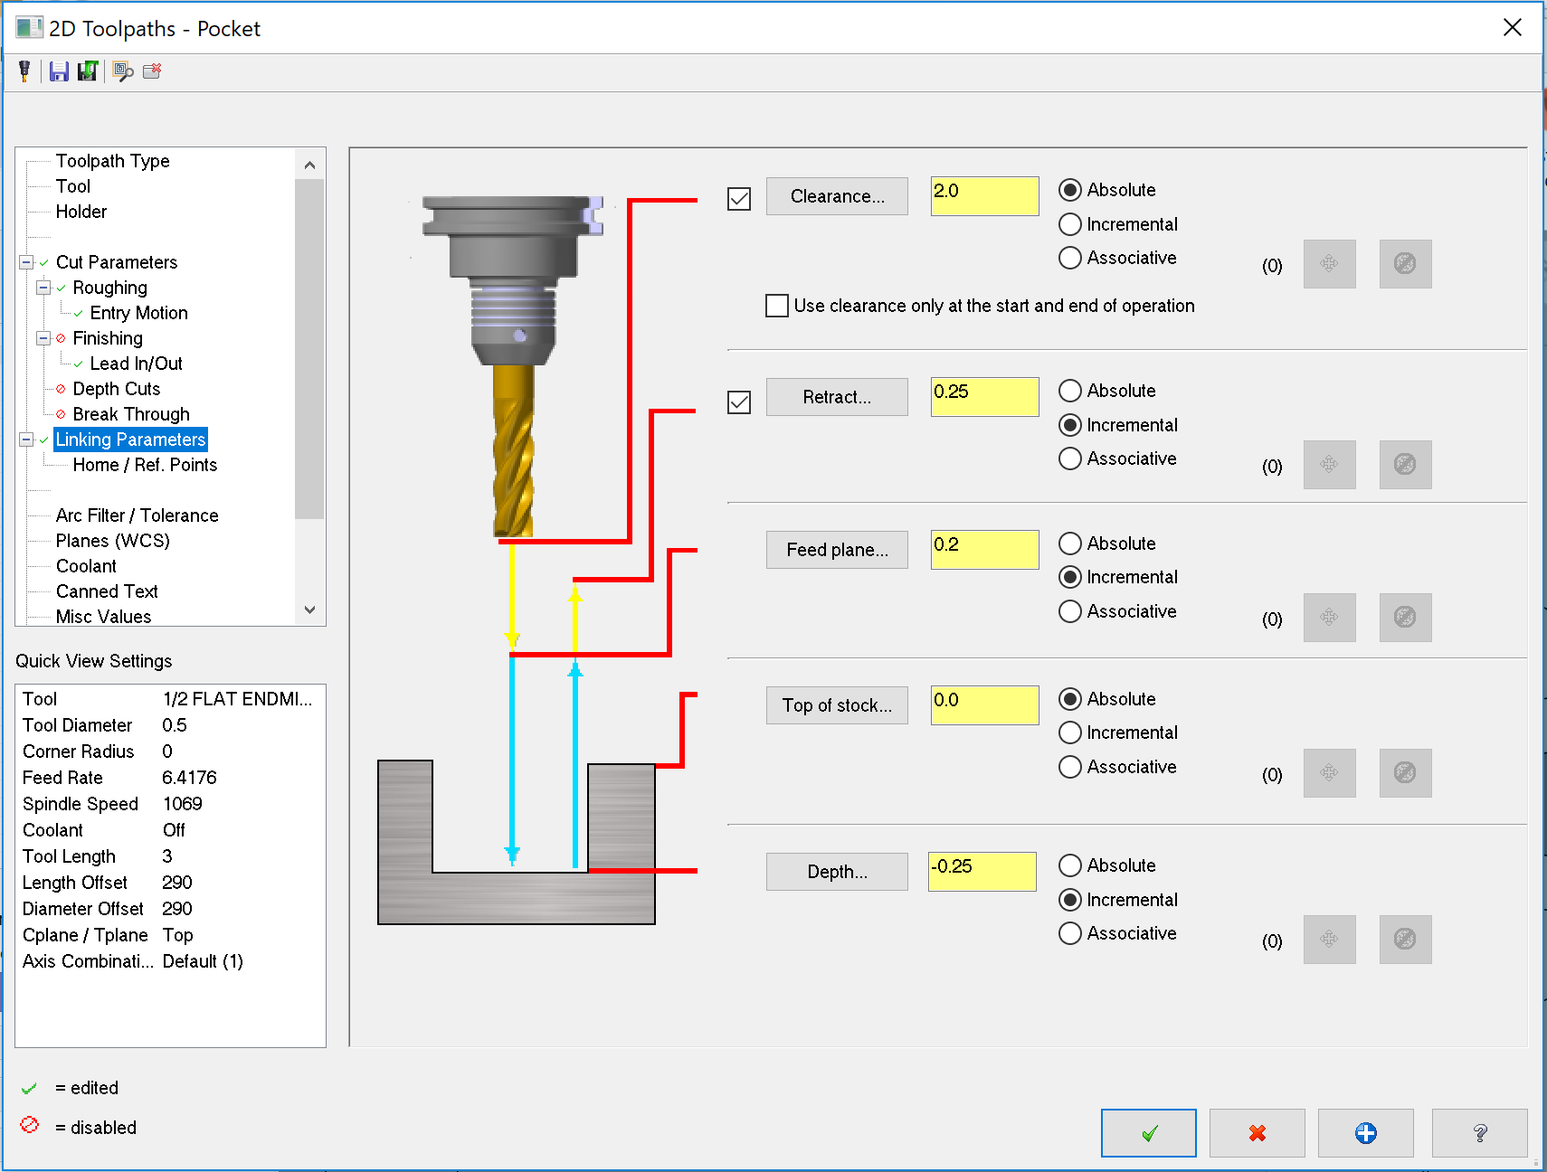
1. Click “Linking Parameters”.
2. Turn on the Clearance plane (the default height of 2.0 will be sufficient).
3. Make sure the “Top of stock” is defined at 0.0.
4. Set the “Depth” to -0.25, to set our depth of the pocket.
5. Confirm

Slide 30
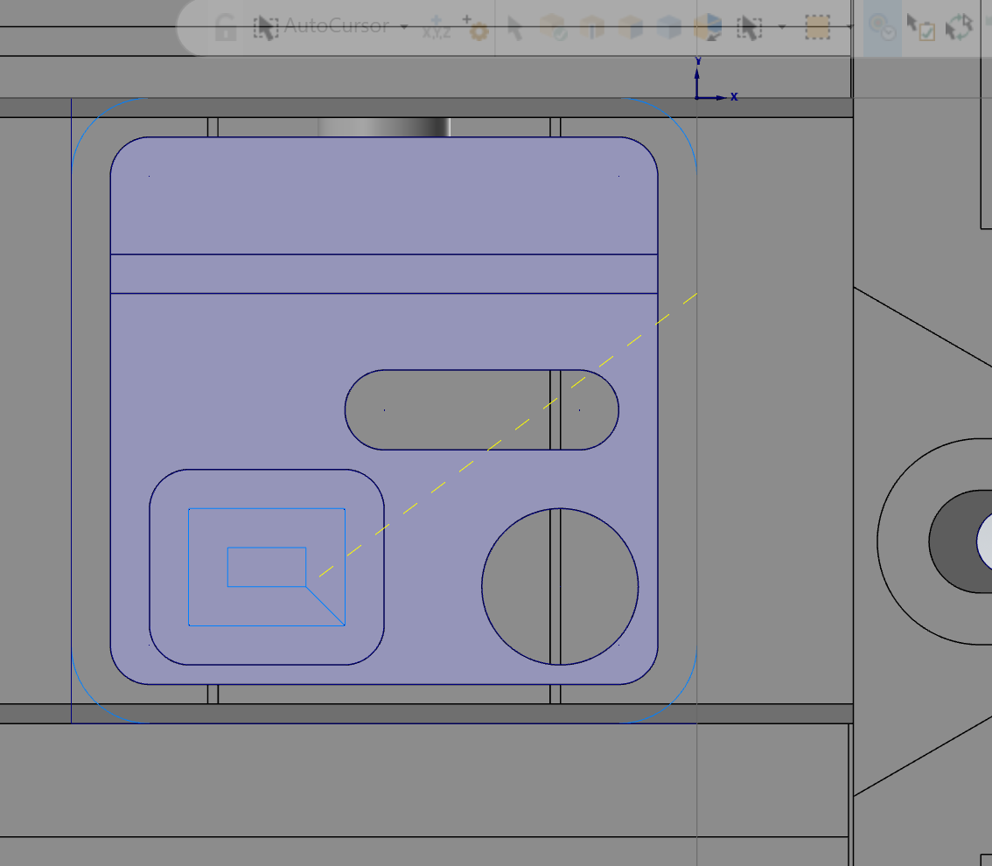
Machine the Circular Pocket and the Slot
Repeat the same steps to program the toolpaths.
Make sure your chain goes CCW around the shape
Set the “Depth” to -0.380 to go through the part.

Slide 31
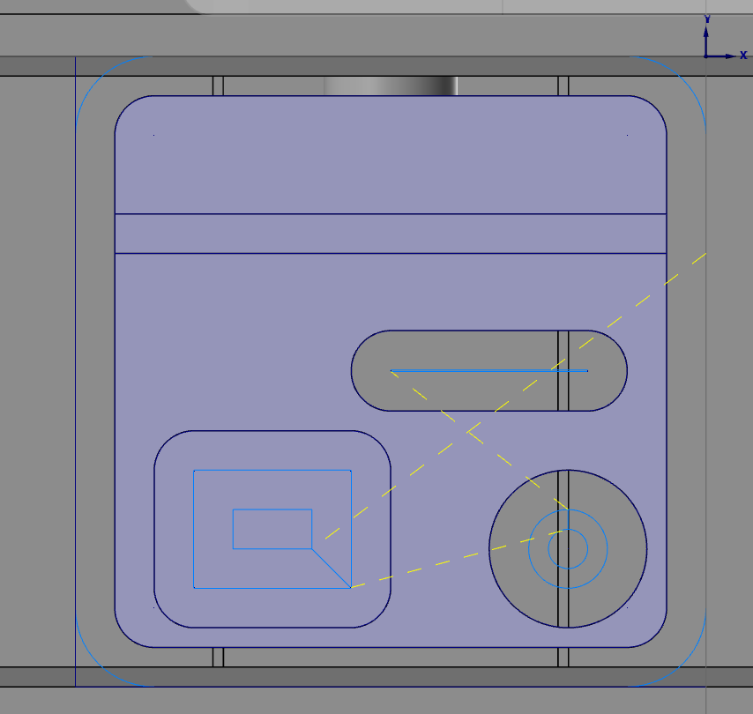
Machine the Circular Pocket and the Slot
Your toolpaths should look like this:

Slide 32
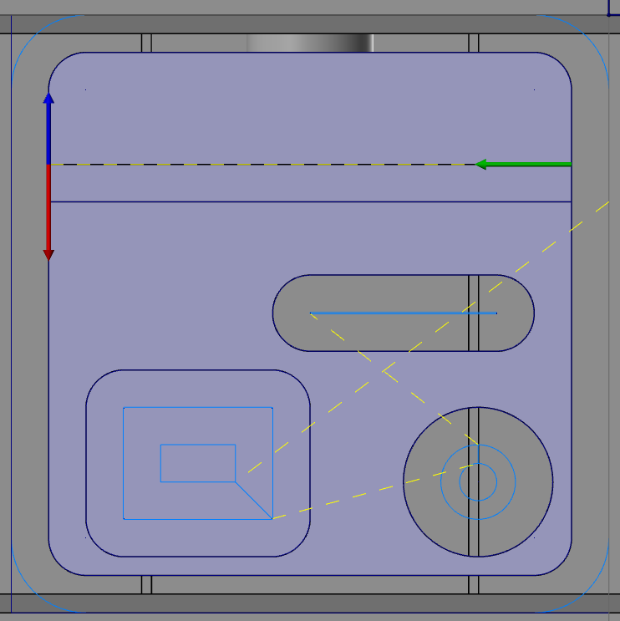
Machine the Narrow Groove
1. Under the 2D Machining Tab, select “Contour” to program the outer perimeter.
2. Click Here
Do NOT Click the Red or Blue Arrow, click the green check in the corner.

Slide 33
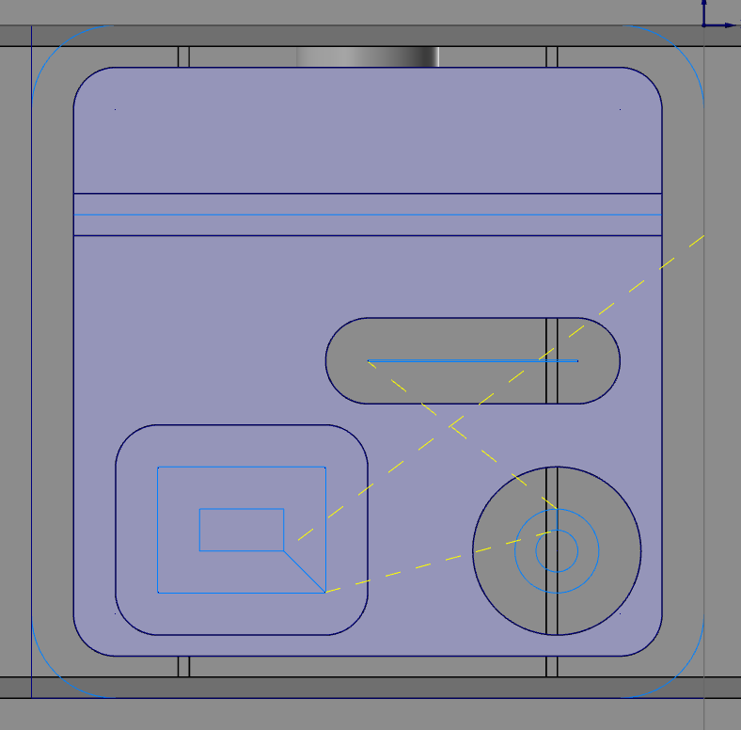
Machine the Narrow Groove
Select the 1/4 Flat Endmill.
Leave no stock on the walls or floor
Turn Lead In/Out OFF
Set the Depth to -0.13
Your toolpath should look like this:
HINT: If you have trouble, make sure you used the ¼ endmill not the ½ endmill.

Slide 34
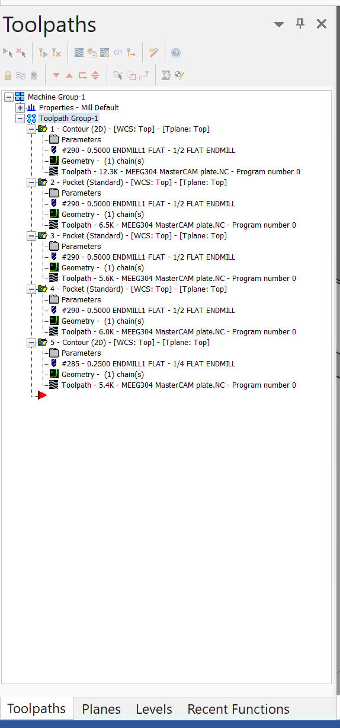
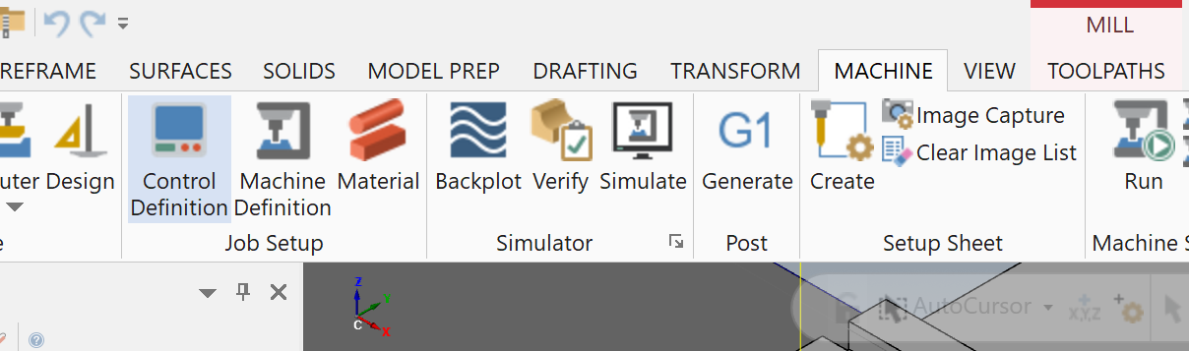
Verify your Toolpath
2. Click “Toolpath Group-1” to select all operations
3. Click on “Machine”
4. Click on “Verify”
1. Click on Toolpaths

Slide 35
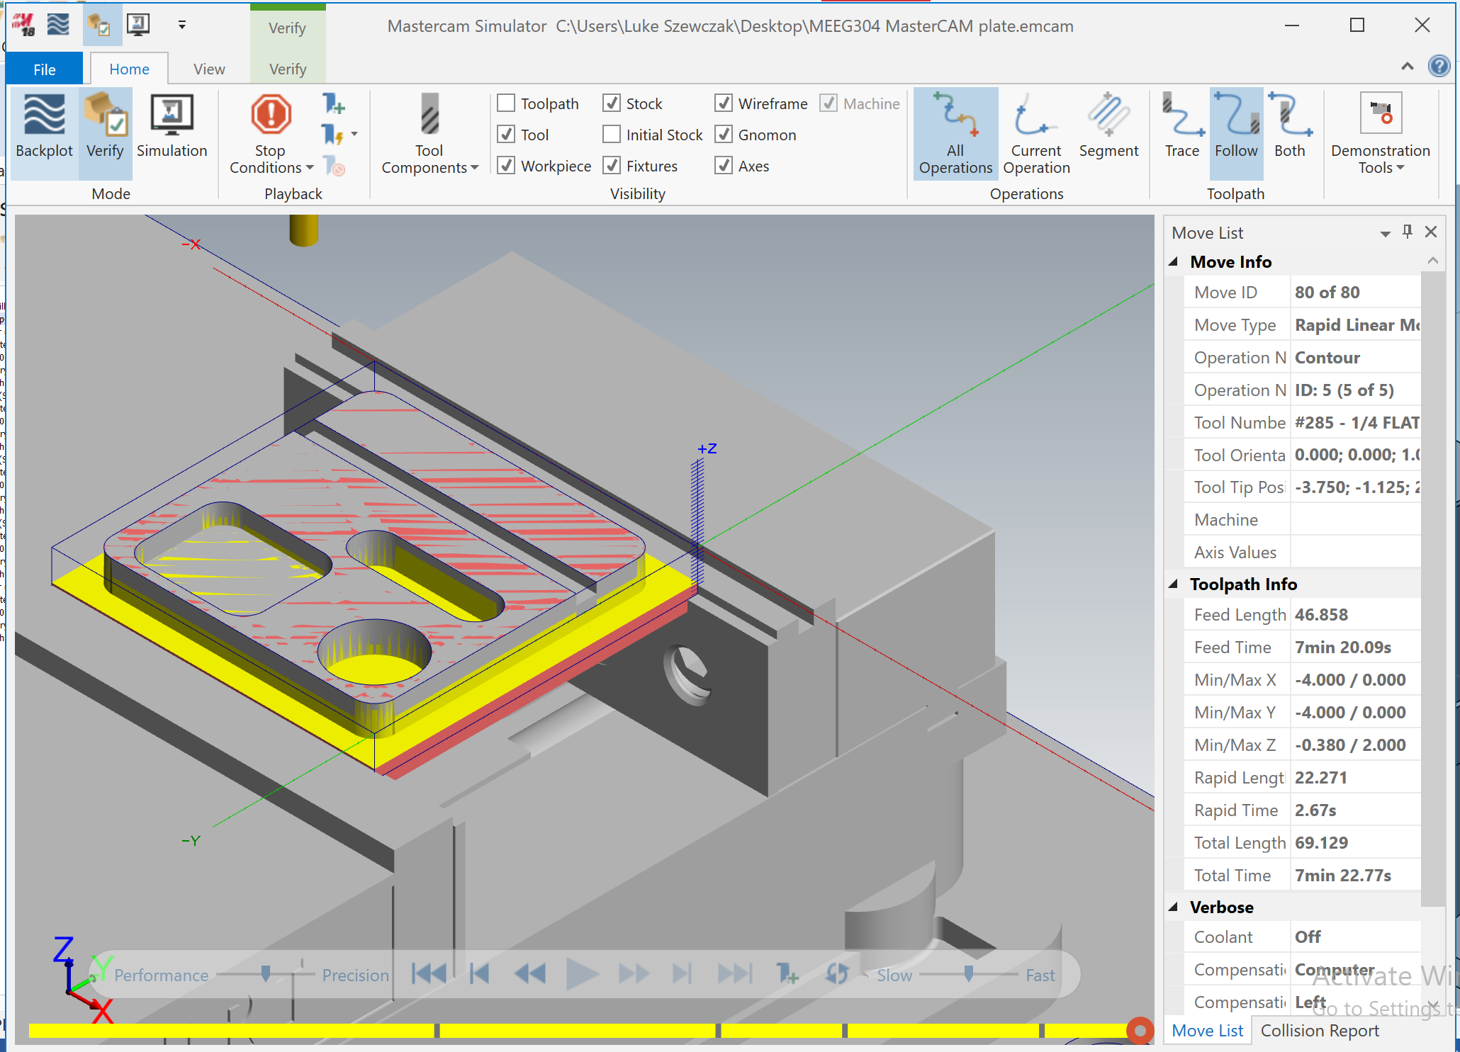
You should press play to verify that your toolpath machines as expected, and does not crash into any other features.
Record the machine time for the Default settings, you will need to submit this time with your report.

Slide 36
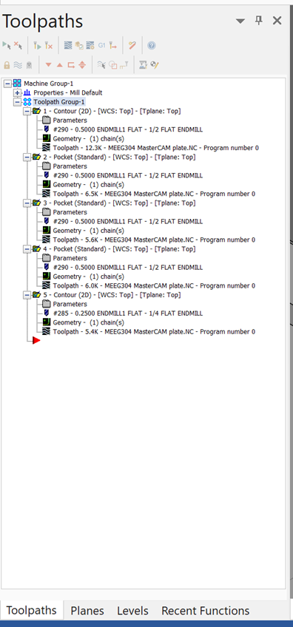
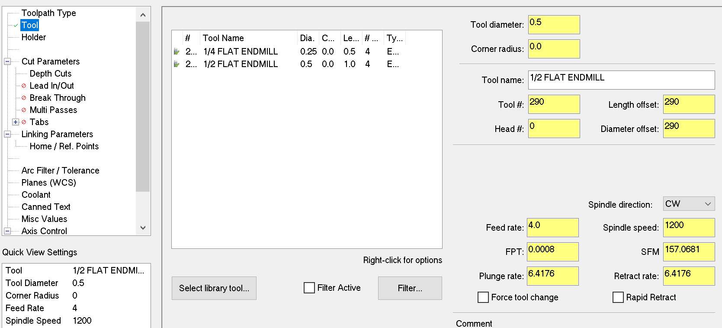
Modify the Machine Feed Rates
1. By Clicking on “Parameters” we can change the toolpath settings.
2. In the “Tool” tab
2. Change the Feed rate to 4.0 IPM and the Spindle Speed to 1200 RPM to represent machining on ProtoTRAK mills

Slide 37
Modify the Other Features
The other pockets that use the ½ tool will use the same feeds and speed rates. (4.0 IPM and 1200RPM).
The slot (1/4 tool) will use 3.0 IPM and 1200 RPM.
Re-verify the part and record the time to calculate the machining time on a ProtoTRAK mill.

Slide 38
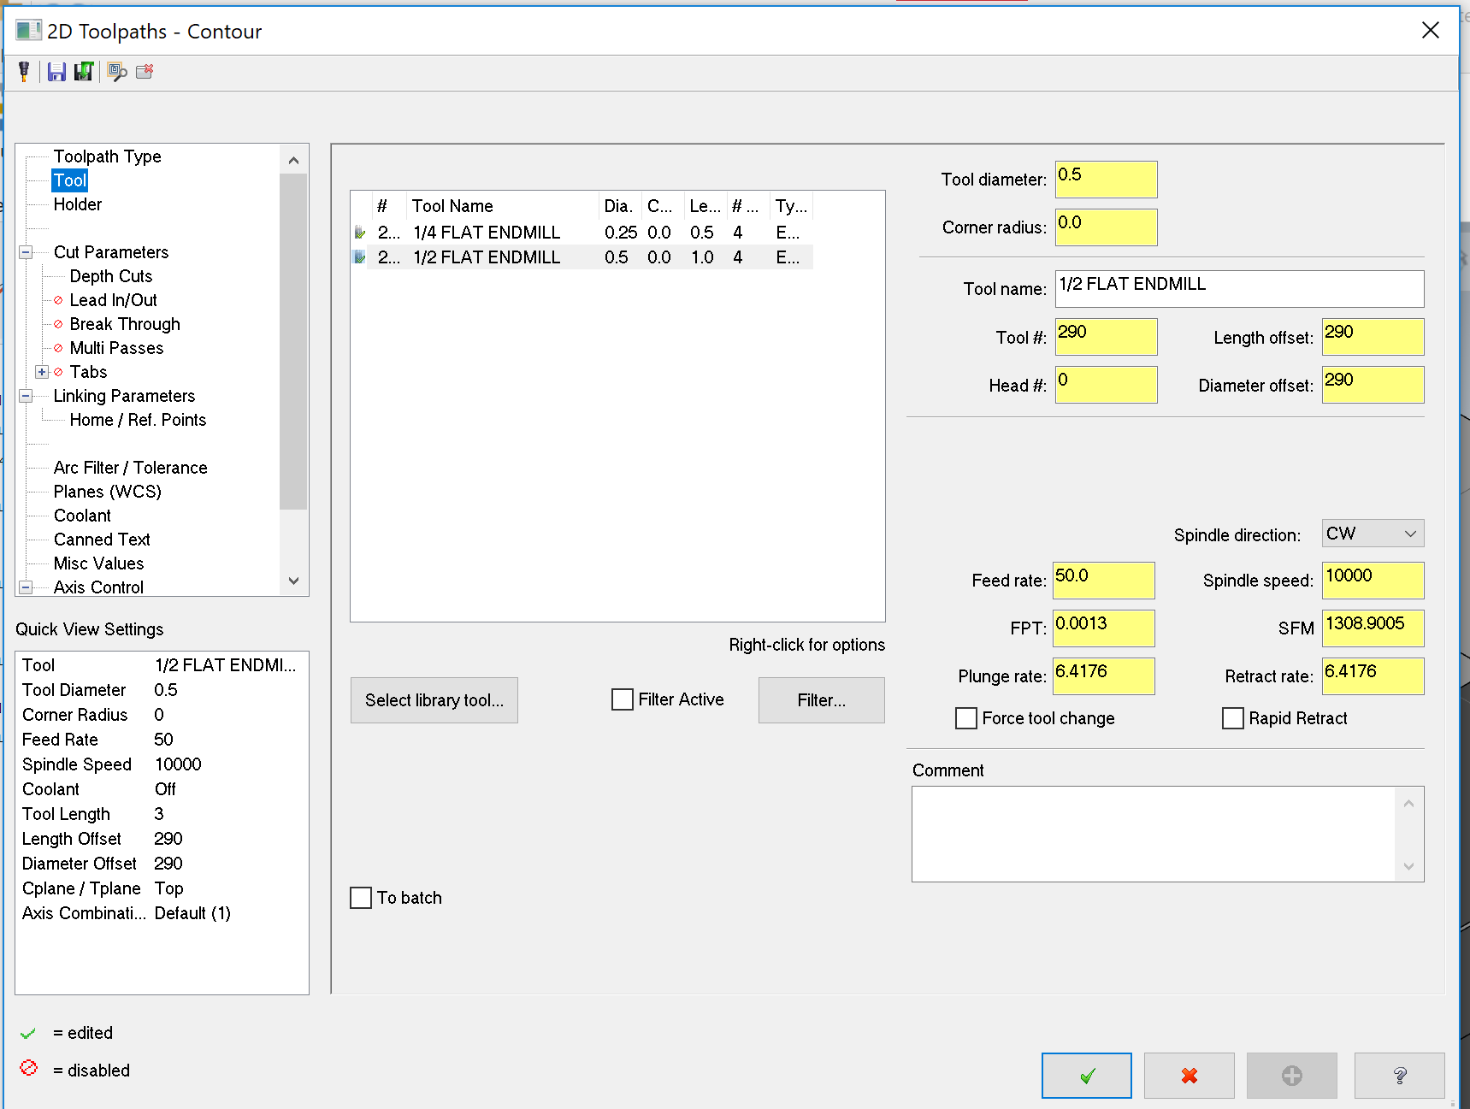
Modify the program to simulate running on the MAZAK
The features with the ½ tool will use: 50 IPM and 10,000 RPM)
The features with the 1/4 tool will use: 30 IPM and 10,000 RPM)
Re-verify the part and record the time to calculate the machining time on a MAZAK mill

Slide 39
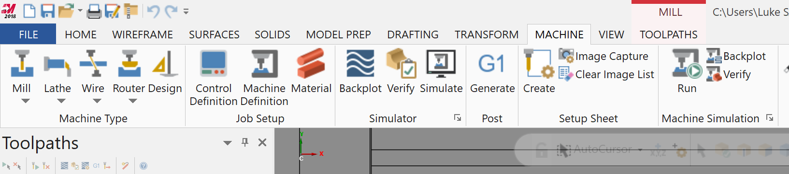
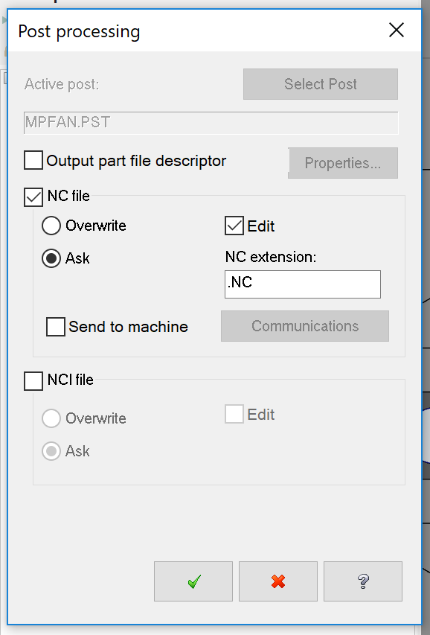
Generate the G-Code from MasterCAM
1. Click the “Machine” tab
2. Click “Generate” under “Post” to generate the G-code.
3. For this assignment we will use .NC files instead of .GCODE files.
4. Check.
5. Save your file as: YOURLASTNAME_MASTERCAM_PLATE.NC

Slide 40
Deliverables
Open a new Word Document, or text file.
Enter your Name and Student ID number.
List and justify your simulation times for the part using:
MasterCAM defaults
ProtoTRAK recommended feeds
Mazak Recommended feeds
Explain the instructions conveyed in 5 lines of your generated code.
The 5 lines of code you will define will begin on the number that is last two digits of your Student ID number.
For example if your UDID is: 702748934, your lines will be 34-38.
You should explain in detail what each of these 5 lines mean, and what motion they correspond to.
Upload this file and your .NC file to Canvas.

